Slide 1
Member Briefing on
Planning & Development
Sustainable Growth Directorate

Slide 2
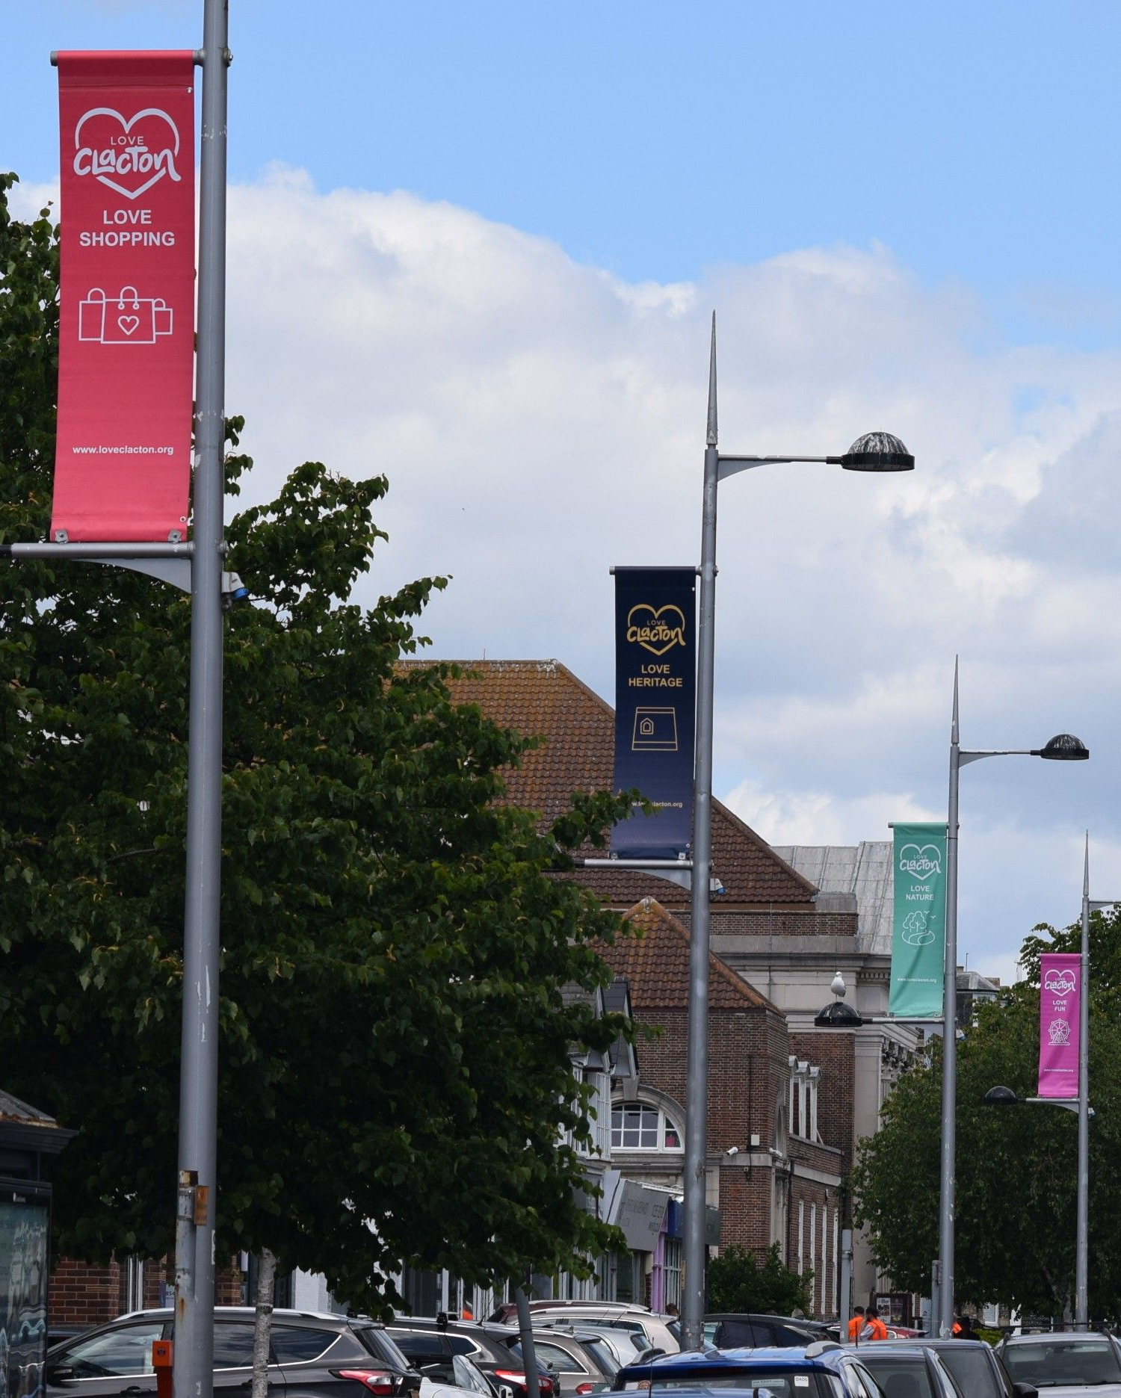
Agenda
Introductions
National, County, District and Parish and Neighbourhood Planning roles
What we do
  Summary of activity
  Run through – planning workstreams
Open discussion
  Priorities 2026/27
  Q and A

Slide 3
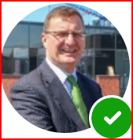
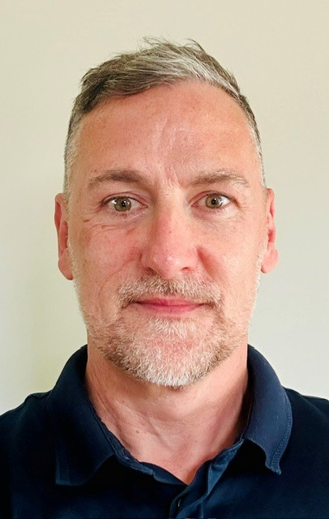

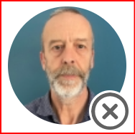

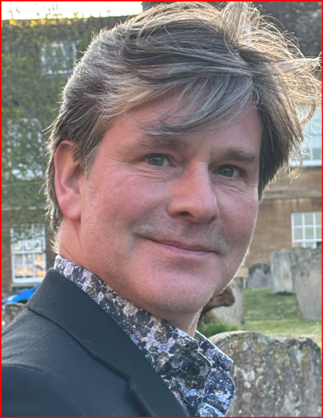
Planning Service Leadership Team
Graham Thomas
Head of Planning and Development
Matthew Jericho
Spatial Planning & Local Plan Manager
James Cutting
Chief Planning Officer County Planning & Development
Alethea Evans
Planning Infrastructure & Finance Manager
Mark Woodger NSIP Manager
Matthew Thomas
Growth and Development Manager

Slide 4
National, County and Local (District) Roles
There are four tiers of Government dealing with Planning. Much control over planning sits with Central Government
Tier | Description
Central Government | Planning Legislation – Planning and Infrastructure Act (2025), Town and Country Planning Act etc National Planning Policy Framework (2025), Written Ministerial Statements and Housing targets Planning Inspectorate (PINS) – Planning Appeals and Local Plan Examinations Secretary of State (SoS) grants consent for Nationally Significant Infrastructure Projects (NSIPs) based on National Policy Statements Permitted Development – enable certain types of development to proceed without planning (GPDO) Use Classes Order – enable different uses i.e. residential, business, shop uses in Town Centres Set building standards – building control Future Homes Standard Provides regulatory frameworks for delivering and maintaining infrastructure – e.g. Utilities
Strategic Planning & County Planning Authority (ECC as Upper Tier) | Spatial Development Strategy (SDS) Minerals and Waste Local Plans As Local Planning Authority determining Minerals, Waste and its own planning applications (e.g. schools, roads, libraries), and Planning Enforcement “Duty to engage” – districts must engage with ECC to shape and inform District Local Plans Statutory consultee and often leading authority on Nationally Significant Infrastructure Projects (NSIPs) Strategic applications including Garden Communities – provide a corporate response Infrastructure Planning and negotiations – Section 106 and Community Infrastructure Levy (CIL) Place and Built Environment Quality – Essex Design Guide, Healthy Homes
Local Planning Authority (Borough, City and District Councils as Lower Tier) | Local Plans – set policy and development standards, and allocate land for homes, businesses etc Determine planning applications (non-County) and maintenance of Planning Register Conservation Areas, Listed Buildings, Article 4 Directions, Tree Preservation Orders Planning Enforcement Building Control
Parish/Neighbourhood Planning Town or Parish Council | Neighbourhood Plans (prepared by a Town or Parish Council)

Slide 5
Planning & Development: Summary of Activity
Strategic Planning &
Local Plans
Prepare Greater Essex Plan (SDS) – an “investment framework” to guide strategic job and housing growth, infrastructure planning and give business and investment certainty, as well as protecting valued landscapes and environments
Shape LPA Local Plans planning policies, infrastructure requirements, duty to cooperate and site allocation selection process bringing forward the best sites for homes and jobs, aligned with infrastructure delivery and environmental protection, and assisting with the evidence
Airports and Aviation Planning – working with Stansted and Southend airports, and the local councils, to maximise growth benefits and protect local communities, as well as influence Government aviation policy for the benefit of Essex
County Planning
The “minerals and waste planning authority” producing Minerals and Waste Local Plans to support the growth agenda
As “County Planning Authority”, determine planning applications for:
  Minerals (e.g. sand and gravel quarries) and waste applications, and Planning Enforcement for these uses.
  ECC’s own applications for planning permission – mostly for infrastructure (e.g. schools, roads, flood schemes)
Delivering Sustainable Development
Place and Built
Environment Quality
Planning for Health
Essex Design Guide
Essex Quality Review Panel
Healthy Homes
Infrastructure Planning
Negotiate to secure S106 contributions required from developers to invest in required infrastructure projects.
Developers’ Guide to Infrastructure Contributions – ECC requirements for securing developer contributions through Section 106 for education, highways, libraries, waste, surface water management (SuDS) etc.
Quality Charter for Growth
Planning and Viability Protocols
Growth and Development
Corporate responses to strategic/large planning applications including new settlements/Garden Communities
Lead on all National Significant Infrastructure Projects in Essex protecting the interests of local people businesses

Slide 6
Strategic Planning
Greater Essex Spatial Development Strategy
What will it do
Set vision, scale and distribution of growth (homes, jobs, infrastructure) – 30 years
Provide a strategic spatial framework for investment and development
Address cross-boundary issues and strategic priorities (transport, energy, health, water, environment)
Prioritises infrastructure requirements
Accounts for the adopted Local Nature Recovery Strategy
Benefits
Market certainty: unlocks investment and funding
Better infrastructure and development integration
Stronger protection against speculative development
Clear framework for Local Plans = faster, more consistent plan-making
Supports economic growth and identifies key infrastructure priorities
Government have legislated, requiring Spatial Development Strategies (SDS) across England. They want to see them in place by July 2029 (Greater Essex is part of the front-runner group).
Challenge
Only ~50% of Essex LPAs have an up-to-date Local Plan
This risks unplanned development, infrastructure gaps, and lower-quality outcomes
Housing delivery ~50% of need; weak land supply and investor uncertainty
“Duty to Co-operate” ineffective: lack of joined‑up, strategic and cross-boundary planning
Key Next Steps
Submit SDS timetable to Government (within 90 days of Regulations being published) – expected to be done early 2027
Continue preparatory tasks – evidence audit, Steering Group, liaising with districts, Member engagement (vision)
Interim Governance Arrangements – Decision by Cabinet in Oct
Begin evidence gathering and plan preparation (once Regulations are laid)
Develop digital platform for SDS data and documentation

Slide 7






What are the benefits of having an SDS?
Market Certainty for investors and developers – stronger investment pipeline
Infrastructure priorities will inform Government funding decisions and align statutory consultees
Identifies the scale of homes and jobs needed for any area over the long term
Protects important areas from development
Clarity on the on strategic locations for growth, opportunity areas, and areas to protect
Reduced cost to the public purse caused by speculative development
Strengthened influence and alignment with infrastructure providers
Synergy
Acts as a spatial investment framework for Greater Essex

Slide 8
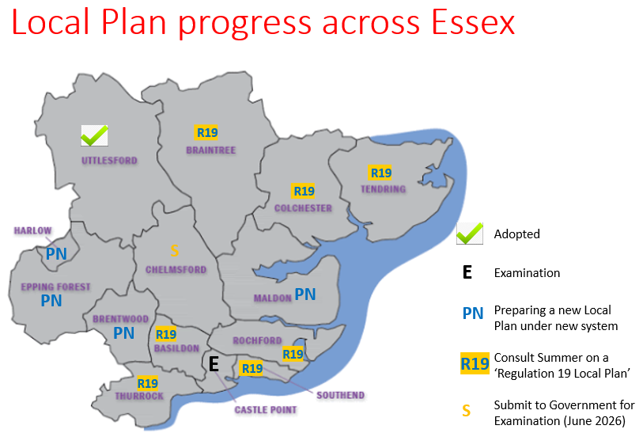
Local Plans
Districts Local Plans provide blueprint for growth and protection for much of Essex (in the absence of SDS), they:
avoid unplanned speculative development that brings poorer quality development and an infrastructure deficit (protecting the ‘public purse’); and
identify key regeneration areas and projects.
Key support provided by ECC:
Shape and inform policies to maximise developer contributions and mitigate the financial cost
Provide guidance to help ensure plans are approved
Highways modelling, education assessment for new schools
Help ensure plans are viable and well-balanced, meet housing and jobs needs and supported by the good infrastructure/developer funding
Duty to engage: Districts must engage with ECC as a statutory consultee on a range of infrastructure/service areas
Local Plans have a combined value of £50bn
Local Plan Progress
6 New Local Plans in preparation (Basildon, Braintree, Chelmsford, Colchester, Tendring, Rochford) – submission by Dec 2026
5 consulting summer/autumn (Chelmsford complete); ECC responses require Cabinet Member sign-off
Castle Point – submitted for Examination (hearings early September)
Uttlesford – adopted March 2026
Brentwood, Epping Forest, Harlow, Maldon – will need “new-style” plans
Southend & Thurrock – preparing plans; consultation summer/autumn (ECC input required)

Slide 9

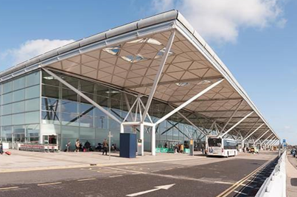
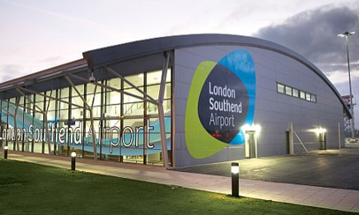
Airports and Aviation Planning

Slide 10
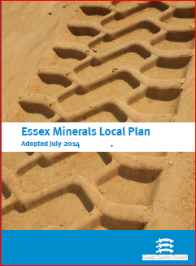

County Planning
While most planning applications are determined by district councils, ECC is the Local Planning Authority responsible for determining:
Minerals (e.g. sand, gravel and rock quarry) and Waste applications;
ECC's own applications (i.e. where ECC is the applicant, such as for works relating to schools, roads, libraries but also for accommodation when discharging care duties); and
these specialisms with different technical elements (e.g. interaction with Environment Agency with enforcement).
Governance
Planning Committee (monthly) considers applications and enforcement; delegation allows Officers to determine many cases
No appeals overturned (2023-25)
New national rules (March 2026): only major applications via Committee; constitutional changes needed by September or default to Officer decisions
96% major and 100% minor applications are determined on time
New regulations March 2026, ECC required to:
By 31 December 2026, submit the revised Minerals Local Plan, or confirm the intention to start again on the new system
Publish a 'first stage assessment' for both Plans by 30 April 2027. This will start a mandatory 30-month timetable for adopting the Plan

Slide 11




Place and Built Environment Quality

Slide 12
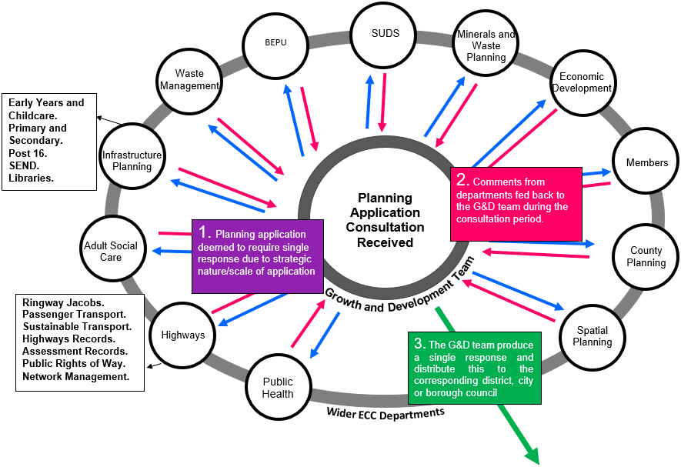
3. Planning and development overview | Strategic Development
Corporate responses to strategic/large applications (750+ homes) and Garden Communities
Process
Provide a corporate response to strategic/large planning applications including new settlements / Garden Communities
Work with a various service areas across ECC
Lead internal discussions required to ensure there is a clear and robust ECC Corporate position
Officers liaise with Local Planning Authorities and negotiate with developers to try and secure sufficient high-quality infrastructure and support good place-making for new and existing communities
Officers are involved in all stages of the planning process including Master- Planning, pre-application and planning application stage

Slide 13
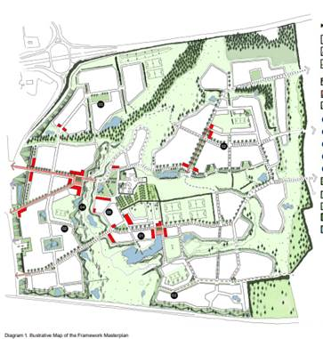
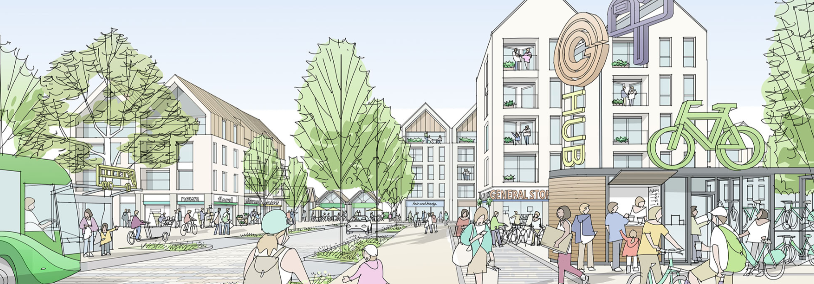
3. Planning and development overview | Strategic Development
Corporate responses to strategic/large planning applications
Outcomes
Required levels of S106 contributions and high-quality infrastructure – in the right places at the right time to meet the needs of residents and fulfil ECC statutory duties
Helps to shape healthy, inclusive, resilient new places with a variety of high-quality homes with a good green environment new schools and employment opportunities.
Dunton Hills Garden Community
Illustrative sketch of Chelmsford Garden Community

Slide 14
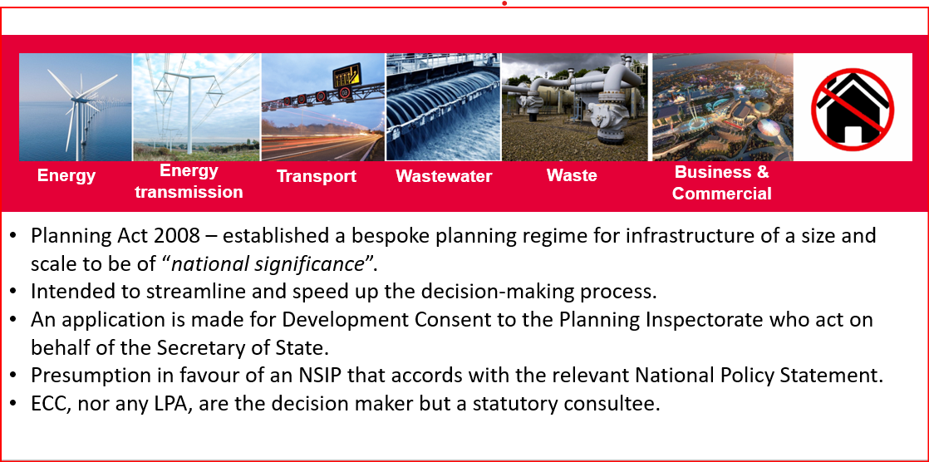
3. Planning and development overview | Infrastructure Projects NSIPs
Nationally Significant Infrastructure Projects (NSIPs)
Notes:
NSIPs cover a wide range of proposals, from off-shore wind farms, electricity network upgrades, energy to water resources, ports, airports and major new road and rail schemes.
Central Government determines NSIPs (the Planning Inspectorate makes a recommendation to the Secretary of State, who makes the final decision)
ECC is a statutory consultee on NSIPS, but is not a decision maker

Slide 15
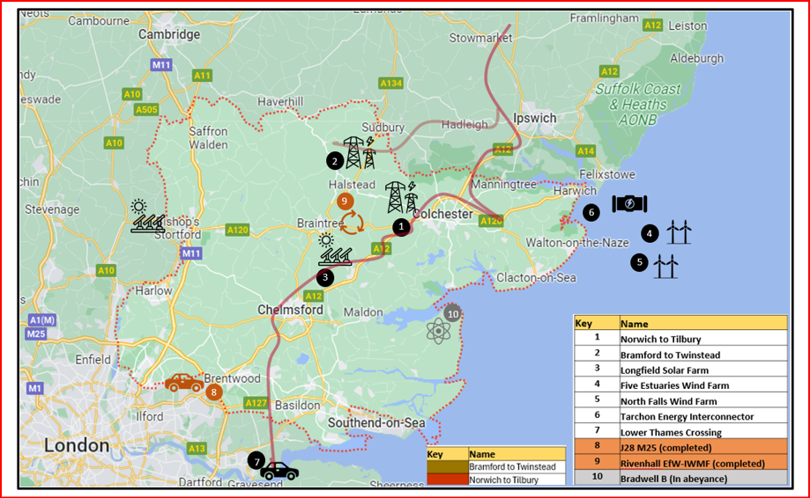
Infrastructure Projects: NSIPs
Project | Project Type | Status
Bradwell B Power station | Energy | Held in abeyance (i.e. project suspended)
M25 Junction 27 Road | Road | Scheme is being implemented
Rivenhall | Energy to Waste | Implemented and operational
Oikos | Energy | Scheme withdrawn
Norwich to Tilbury | Electricity Transmission | At the Hearing with the Planning Inspectorate.
Lower Thames Crossing | Road | Scheme is moving to delivery phase.
Bramford to Twinstead | Electricity Transmission | Construction works have started
Five Estuaries Wind Farm | Offshore Wind | Scheme has permission, start date later in 2026
North Falls Wind Farm | Offshore Wind | Examination Hearings completed, decision due on 14/05/26.
Tarchon Interconnector | Electricity Transmission | Application expected summer 2027. Early work Expect Likely to be submitted in Q2 2027
Longfield Solar Farm | Solar | Has permission, due to build mid 2026
ECC’s Role in Nationally Significant Infrastructure Projects (NSIPs)
NSIPs include major infrastructure such as wind farms, energy, water, ports, airports, and road/rail schemes
Determined by central government (via the Planning Inspectorate and Secretary of State) to streamline and speed-up decisions
ECC is a statutory consultee, not the decision-maker
ECC leads coordination (as set out in ECC’S Guide to NSIPs) to:
  protect local communities, places, and the environment while maximising economic benefits
  secure mitigation and lasting community benefits, including environmental improvements and growth
95% of NSIPs achieve consent

Slide 16
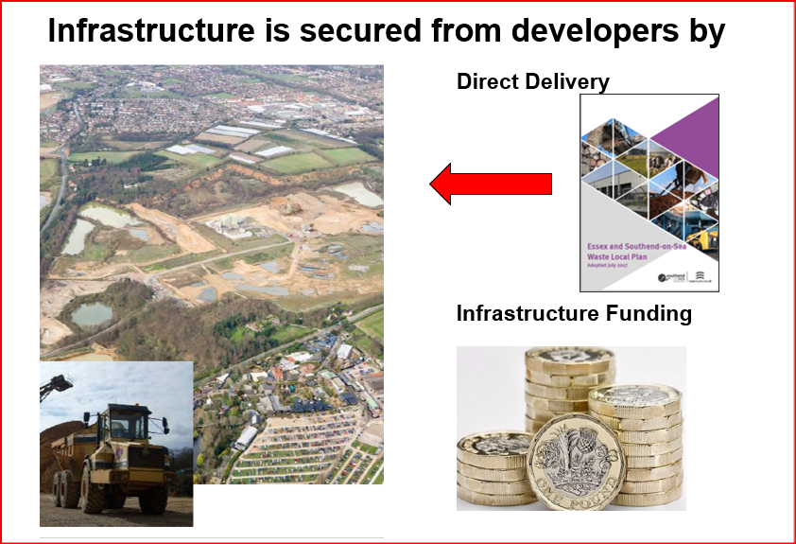
Planning and development overview | Infrastructure planning & system leadership

Slide 17
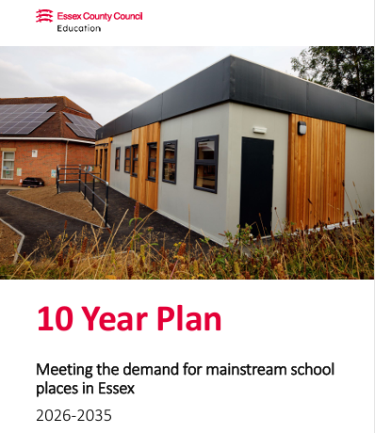
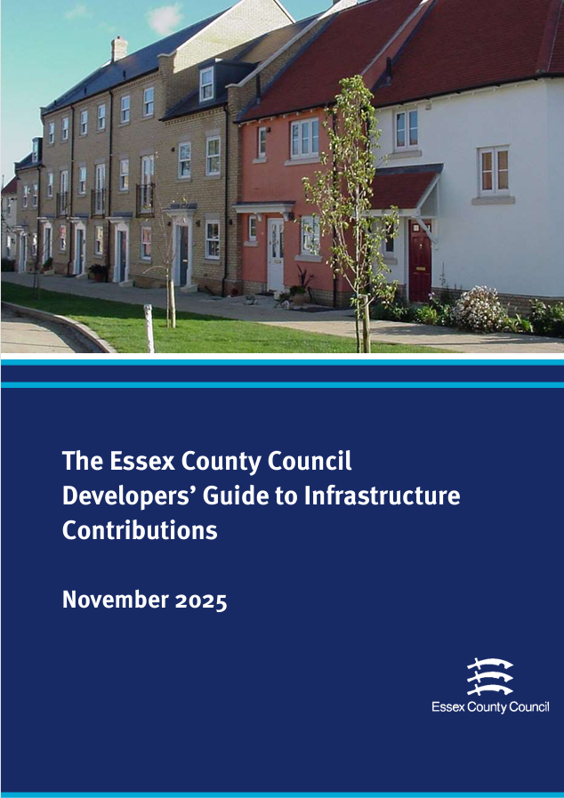
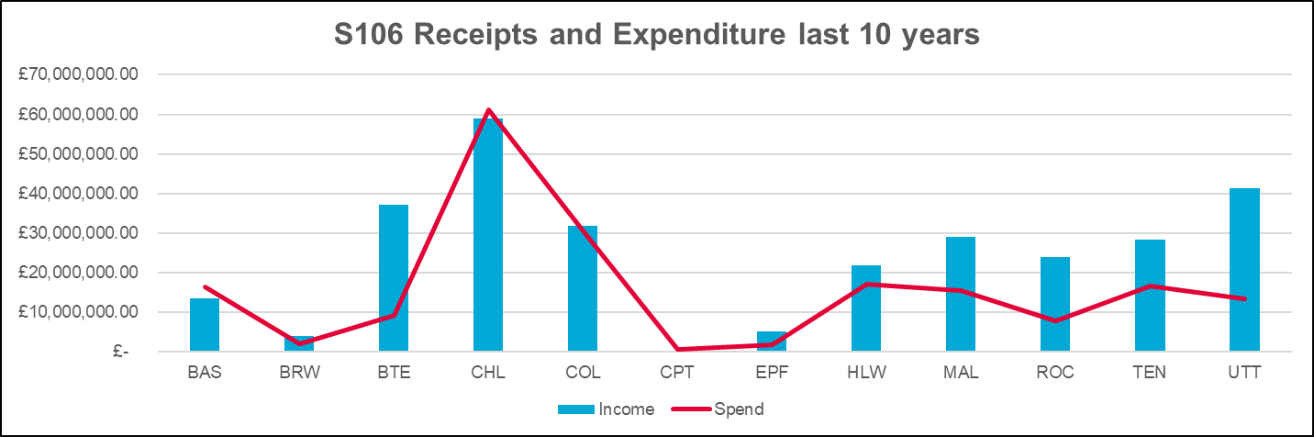
Infrastructure Planning & System Leadership
Securing Section 106 contributions from developers
S106 funds education (schools/pre-schools) and direct delivery of transport improvements
Strong S106 negotiations reduce public cost and avoid retrofitting infrastructure
Higher funding available where Local Plans are up to date
ECC typically seeks direct developer delivery of roads
£118m of S106 is for education
Delivering S106
Infrastructure should be planned for delivery to meet needs, balancing timing and funding
“Infrastructure first” not appropriate for education
ECC has a statutory duty to publish an annual Infrastructure Funding Statement
ECC has added a delivery section to document spending and showcase infrastructure delivered through S106 funding
S106 balance (April 2025) is £169 m

Slide 18
Key work priorities in 2026/27
Mineral Local Plan – autumn 2026 or commence preparation of new Minerals and Waste Local Plan
100 Day Plan – Oppose the Norwich to Tilbury - Nationally Significant Infrastructure Project
Garden Community planning applications – Dunton, Chelmsford and Tendring Colchester Borders - plus, new Garden Communities
Spatial Development Strategy for Greater Essex – autumn 2026
Shape and support District Local Plans - especially those at examination
100 Day Plan – Strategic Green Belt Review
Prepare for Change – LGR and Devolution
Maximise income generating work in
2026/27 - fees, PPA’s and grant income
Lead on minimising water usage in new homes
and related efficiencies

Slide 19
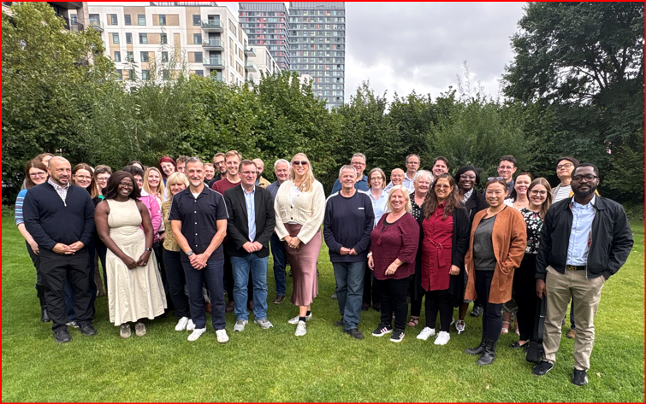


Slide 20
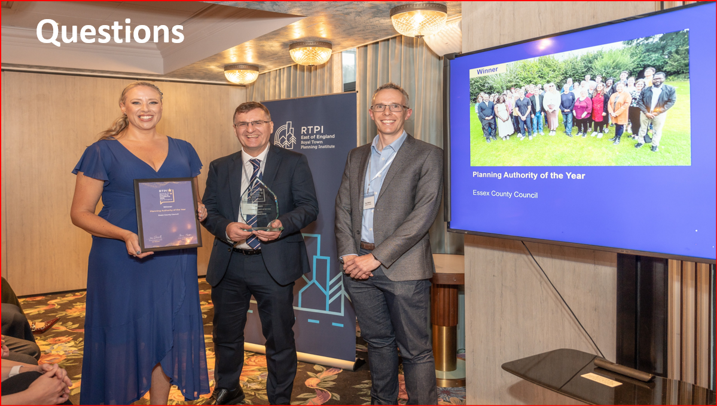
Upcoming Meetings & Decisions
Greater Essex Plan (SDS):
A vision / ambition for Greater Essex is required
Governance arrangements need to be agreed by ECC, Thurrock and Southend (late Sept submit SDS timetable/programme)
Local Plans: CMAs signed over summer for ECC responses to advanced Local Plan consultations (7 due this year)
Determine county planning applications:
Agree composition of the Planning (Development and Regulation) Committee
Update the constitution (summer/autumn 2026) to ensure compliance with the new legislation and plan making system
Decision expected Dec 2026–Jan 2027 to consult on April 2027 planning fee changes (national guidance update)
Minerals and Waste Local Plan(s)
Determine whether to proceed with submission of Minerals Local Plan or withdraw and publish existing evidence (Early September 2026)
To submit a Minerals Local Plan – a Full Council Decision is required in October 2026 to consult on the revised draft Mineral Local Plan (submission version).
26 June
Development and Regulation Committee
Oct Full Council
Minerals Local Plan (TBC)
JUNE | JULY | AUGUST | SEPTEMBER | OCTOBER | NOVEMBER
23 June
Chelmsford Garden Community
member board meeting
Sept Full Council
SDS Governance report

