Slide 1


Briefing for New Members
Education
May 2026

Slide 2

What is the Local Authority Required to do?
The overwhelming majority of Education services are driven by statutory requirements set out in the relevant legislation.
The Local Government Association has produced a very useful, high level summary of the statutory duties of local authorities that are responsible for education.
This can be accessed via the link below.
https://www.local.gov.uk/publications/must-know-guide-education

Slide 3
What is Local Authority Education Function?
Local Authority Education Services cover a broad range of support to schools and children to ensure children and young people can achieve the best outcomes and live fulfilling lives when leaving school. These services include:
School admissions and school place planning
Early Years
Sufficiency of Places and Early Support in collaboration with Health partners
Special Educational Needs and Disabilities (SEND) Assessment, placements, sufficiency, places, provision
Alternative provision for children unable to attend school
Youth Work
Young Carers
Education Capital Investment
Elective Home Education/Not in Education, Employment or Training (NEET)
Home to School Transport
School standards and school improvement duties including Traded Services to Schools / Music Service
Education Funding Distribution
School Attendance
Safeguarding and wellbeing duties
Virtual school
School Crossing Patrol
Children Missing Education

Slide 4
Legislative Duties:
There are various pieces of primary and secondary legislation, alongside government statutory guidance, that govern the functions of local authorities in the field of education. These include but are not limited to:
Education Act 1996
School Standards and Framework Act 1998
Education Act 2002
Education and Inspections Act 2006
Academies Act 2010
Education Act 2011
Children’s Wellbeing and Schools Act 2026
Children and Families
Act 2014
SEND Code of Practice 2015
School Admissions Code 2021
Early Education and Childcare 2025
Keeping children safe in Education 2025
There are also several other statutory guidance documents that cover school attendance, looked after children, alternative provision and provision for excluded pupils and school improvement to have due regard to as well.

Slide 5
The policy landscape.
Victims & Prisoners Act 2024
Crime and Policing Bill
Online Safety Act 2023
Victims and Courts Bill
Mental Health Act 2025
Children’s Wellbeing and Schools Act 2026
Sentencing Act 2026
Border, Security, Asylum & Immigration Act 2025
Families First Partnership Programme
Sexual abuse: implementation IICSA / Casey Review: Grooming Inquiry; VAGW Strategy
Focus on Prevent, Youth Violence, Youth Radicalisation, Southport
Schools White Paper and SEND reform
Reform of Fostering and Adoption Support
Reform of Youth Justice & secure estate
Young Futures Programme including Hubs
Reform of Ofsted & CQC
Early Years: Best Start in Life Strategy: Childcare; Best Start Hubs; EY Education
National Child Poverty Strategy
National Youth Strategy & investment in youth provision
Review of legal frameworks: CWD & Kinship
NHS Ten Year Plan
Safer Digital Futures
School standards; Curriculum Review; new education inspection & accountability framework
Regionalisation
Welfare reform / benefits overhaul; Get Britain Working White Paper
Crime & Safety
Knife crime / safer streets / VAWG / Policing White Paper
Housing standards, tenants' rights, growth
Economy & Skills post-16 pathways
Neighbourhoods: Pride in Place Strategy
Tech and AI in public services / growing awareness of tech & impact of online world
Courts: reform of family & criminal; Sentencing Review
Asylum: Strengthening of borders, crack down on illegal immigration, limits to legal routes
Adult Social Care: charging reform
Devolution and LGR

Slide 6
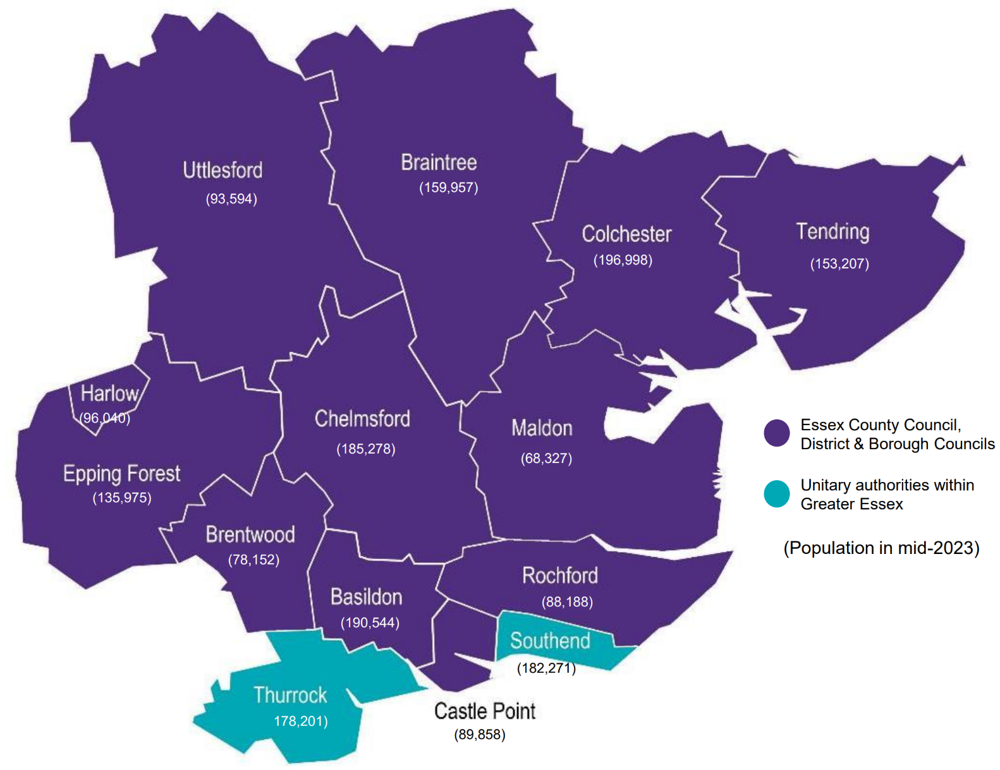
A snapshot of Education in Essex
1.56 million resident population
222,617 children in Essex schools
556
Schools and Alternative Provisions
1,795 Early Years settings
20.3% children receiving Free School Meals
25.9% pupils from black and ethnic minority backgrounds
11.8% pupils with English as an additional language
16,388 Education, Health & Care Plans
4,938 children Electively Home Educated
6.9% Absence Rate
(2024/25)
193 Permanent Exclusions (2024/25)
7,620 new school places required by 2035
Children estimated to be living in poverty 13%
Notes:
Same as CSC – anything to add?
Levels of attendance
Published data on permanent exclutsions
NB: Notes on stats
Total Pop – 1.896K
Children with Free school meals, school from global majority, those with English as an additional language were all provided as % - so couldn’t aggregate. I have got comparator data from education and been able to calculate but it is as of last January school census – 2025 not yet available.
%EHCPs – calculated using known school numbers
Issue with number of children living in poverty – I don’t know how they defined this and there is quite a disparity between Southend, Thurrock and Essex. I do have a figure for greater Essex for “% of LSOAs in top decile of deprivation in England” with is 4% but it is not the same measure as before.
Additional school places – Thurrock stated to 2031 not 2030 but added them all together as thought its probably fine as only a yr out
I have “4% of LSOAs in top decile of deprivation in England”

Slide 7




Pupil Journey
Early Years & Childcare
Primary School
Post 16 destinations
Secondary School
Attendance
Children Missing Education
Elective Home Education
Permanent Exclusions/ reduced timetables
Youth Service
NEET
Virtual School
SEND
SAFEGUARDING

Slide 8
Education Structure Chart
Helen Lincoln, Executive Director for Children, Families & Education
Clare Kershaw
Director, Education
Daniel Gee
Assistant Director of Education North
Lisa Fergus
Assistant Director of Education South
Nicola Woolf
Assistant Director of Education West
Catherine Hutley
Assistant Director of Education Mid
Michael O’Brien
Head of Specialist Education
Shamsun Noor
Head of Education Operations
Ralph Holloway
Head of SEND Strategy and Innovation
Jo Barclay
Head of Education Safeguarding & Wellbeing
Anita Kemp & Gareth Honeyford
Head of Strategy Development & Performance
Quadrant SEND Statutory Service
Quadrant SEND Teams including Inclusion Partners, Engagement Facilitators and Educational Psychologists
Quadrant School Effectiveness Team
Quadrant Early Years Team
Quadrant Attendance Team
Quadrant SEND Statutory Service
Quadrant SEND Teams including Inclusion Partners, Engagement Facilitators and Educational Psychologists
Quadrant School Effectiveness Team
Quadrant Early Years Team
Quadrant Attendance Team
Quadrant SEND Statutory Service
Quadrant SEND Teams including Inclusion Partners, Engagement Facilitators and Educational Psychologists
Quadrant School Effectiveness Team
Quadrant Early Years Team
Quadrant Attendance Team
Quadrant SEND Statutory Service
Quadrant SEND Teams including Inclusion Partners, Engagement Facilitators and Educational Psychologists
Quadrant School Effectiveness Team
Quadrant Early Years Team
Quadrant Attendance Team
Youth Work
Young Carers
NEET Tracking
Children Missing Education
Elective Home Education
Attendance Compliance
Music Service
Alternative provision
SEND Advisory Service
The Virtual School
School Admissions (mainstream)
School Transport eligibility
Free school meals eligibility
Early Years Sufficiency and Sustainability
Children in Employment and Entertainment
Schools Comms and Data
SEN strategy and transformation
SEN commissioning funding, sufficiency and capital
SEN tribunals
Preparation for Adulthood
Parent and pupil voice and participation
Specialist teaching services.
Essex Family Forum
Strategic advice and support for safeguarding
Training programme
Provision of safeguarding guidance
Investigation of safeguarding concerns
Improvement, development and quality assurance to strengthen safeguarding in all education settings
Represent Education at Essex Safeguarding Children Boards/ other strategic Boards
Lead on Prevent and Channel Panel
Workforce Development, internal and the education sector
School Crossing Patrols
Essex School Meals Advisory Service
Essex Education Task Force Project Delivery
Cross organisational engagement
LGR lead

Slide 9
Changing nature of Education in Essex
Statutory school age education
Delivered by LA maintained and Multi Academy Trust Schools
Schools having to do much more with much less
Recruitment of teachers and support staff remains a national issue
Schools need to be more inclusive, teaching children who would have been educated in specialist provision in the past.
Increase in non school attendance and Elective Home Education (EHE) since the pandemic. This has increased safeguarding risks with fewer children being seen in school on a regular basis.
Early years and Childcare
Delivered in schools and by private, voluntary and independent (PVI) providers.
New statutory duty on LAs to provide sufficient childcare places
Changing needs of children
Increase in children with special educational needs is well documented. SEND reform proposals have been published as part of the Schools White Paper and legislation was proposed in the recent King’s Speech.
Provision for children with more complex needs and at a higher cost.
Special Education Needs and Disability (SEND) provision
Challenge nationally is well documented and waiting for the national reforms from the government
Challenges impacting at regional and local level with increases in the number of education, health and care plans (EHCPs) placing pressure on budgets’
Rapidly changing education landscape
New Ofsted Framework and changes to curriculum and assessment
Children’s Wellbeing and Schools Act, Schools White Paper and SEND Reforms (under consultation).

Slide 10
Statutory Guidance on Directors of Children’s Services and Lead Members
Every Local Authority must appoint a Director of Children’s Services (DCS) who has statutory professional responsibility for the delivery of social care and education services in accordance with relevant legislation. The DCS must:
Work with headteachers, school governors and academy sponsors and principals to promote educational excellence for all children and young people and be ambitious in tackling underperformance.
Secure the provision of services necessary to address the needs of all children and young people, including the most vulnerable and disadvantaged, and their families and carers.
Work with partners to improve the outcomes and wellbeing of children and young people.
Take responsibility for the performance of both children’s services and education functions.
Every Local Authority must also have a Lead Member for Children’s Services who has statutory political responsibility for the leadership, strategy and effectiveness of children’s services and education. The Lead member must provide effective oversight of the discharge of local authority functions, strong strategic leadership, and support and challenge to the DCS.

Slide 11

Safeguarding
It is the responsibility of local authorities and relevant partners to safeguard and promote the welfare of children and young people under Section 11 of the Children Act 2004.
Expectations of how this should be done are set out in Working Together to Safeguard Children 2026.
Safeguarding is a proactive approach that aims to prevent harm and promote welfare.
Child Protection is a specific reactive process that takes place when a child is at risk of or experiencing significant harm.
Effective safeguarding practices across an area, delivered by multi-agency partnerships, should ultimately limit the number of children requiring child protection.
Risk however cannot be fully removed from systems – we work with ‘safe uncertainty’.
Safeguarding Children Boards
Within the local authority three ‘Safeguarding Partners’ are legally responsible for the effective operation of safeguarding practice.
These are the Local Authority, the Police, and Health.
The Safeguarding Partners must establish ‘Multi-Agency Safeguarding Arrangements’ to enable co-operation and ensure effectiveness and should ensure the appropriate representation of other agencies (including education) within these.
In Essex, Education act as a statutory partner and participate in those meetings and processes
Safeguarding Boards are just one of a number of partnership forums through multi-agency responsibilities related to social care and safeguarding are discharged.
)
Notes:
Talk about safe uncertainty , and how ever effective child protection is there will always be incidents …..

Slide 12
Sufficiency Duty
Duty to Secure Sufficient Childcare:
Local authorities must ensure, as far as is reasonably practicable, that there is sufficient childcare for working parents or parents in education / training.
School Places:
Duty to provide enough school places for children living in Essex - including children with Special Educational Needs and / or a disability.
School admissions:
Statutory co-ordination of admissions for all children starting infant, primary, junior and secondary school each year.
Co-ordination of mid-year admissions for all community and voluntary controlled schools and securing of places for parents unable to secure one.
Publication of admissions policies for all schools across Greater Essex.
Setting of admissions policies for all community and voluntary controlled schools.
Handling of independent admission appeals for all community and voluntary controlled schools.

Slide 13
What are our Strategies
Inclusion Strategy
Inclusion vision and strategy | Essex Schools Infolink
Early Years and Childcare Strategy
Early years and childcare strategy | Essex County Council
Partnership Strategy
School Partnership Strategy: School Partnership Strategy | Essex Schools Infolink
SEND Strategy
SEND Strategy | Essex County Council

Slide 14
Childcare must be available to support parents to be able to work or study and is broken down by:
Early Years - childcare from birth up to the term after a child’s fifth birthday and also includes access to a funded early education entitlement place for children from the term after they turn 9 months up to school age.
School Age - childcare for children aged 5 to 14 years (or up to 18 years for young people with an education health and care plan).
The provision is provided by:
Private, voluntary and independent (PVI) providers (pre-schools, day nurseries, out-of- school providers and independent schools)
Childminders and Childminder Agencies
Maintained providers (schools, academies, Further Education colleges and maintained nursery schools).
What do we mean by
‘Early Years and Childcare’

Slide 15
Statutory duties for Local Authorities
Duty to Secure Sufficient Childcare:
Duty to Secure Sufficient Children’s Centres:
Duty to Provide Funded Early Education:
Duty to Provide Wraparound childcare for school aged children:
Duty to Assess Childcare Provision:
Local authorities must ensure, as far as is reasonably practicable, that there is sufficient childcare for working parents or parents in education / training
Secure sufficient children / Family centres that are accessible to all families with young children, and targeted evidence-based interventions for those families in greatest need of support
Authorities must secure funded early years provision for eligible children from 9 months old up to school age
Meet the childcare needs of families with children over the age of five through out-of-school care and provision for children and young people up to the age of 14 (or to 25 for children with disabilities) ​
Local authorities are required to assess the childcare provision in their area to ensure they can meet the needs of parents

Slide 16
Statutory duties for Local Authorities cont…
Duty to Provide Information, Advice and Guidance:
Duty to Ensure Quality of Childcare and Early Learning:
Duty to Safeguard and Promote Welfare:
Duty to Meet the Needs of Children with SEND:
Provide information, advice and assistance to families through providing:
a Families Information Service (FIS)
a SEND Local Offer
Secure information advice, guidance and training for childcare providers
Support improvement in the quality of childcare
Safeguard and promote the welfare of all children throughout all aspects of the work of Early Years and Childcare with specific regard to ensuring that early years and childcare providers understand their responsibilities and are accountable for their practice
Ensure that all providers delivering funded early education places meet the needs of children with Special Educational Needs and / or Disabilities in accordance with the SEND Code of Practice 2015

Slide 17
What is meant by SEND?
A child or young person has a Special Educational, Need and/or Disability (SEND) where their learning difficulty or disability calls for special educational provision (provision different from or additional to that available to all pupils of the same age).
The areas of need are:
Communication and interaction
Cognition and learning
Social, emotional and mental health difficulties
Sensory and/or physical needs
SEN Support: Schools should take action to remove barriers to learning and put effective special educational provision in place, for those children identified as having SEN. This ‘SEN support’ should take the form of a four-part cycle, known as the graduated approach (assess, plan, do, review). In Essex we call this One Planning.
EHCP: Where, despite the school having taken relevant and purposeful action, the child or young person has not made expected progress, the school or parents should consider requesting an Education, Health and Care needs assessment from the local authority. Some of these needs assessments will result in an Education, Health and Care Plan (EHCP).

Slide 18
Our Duties
Schools, the LA and Health services have legal duties regarding SEND under the
Children and Families Act 2014 and the SEND Code of Practice 2015.
Identification and Assessment
Local authorities, schools, and health services must identify and assess the special educational needs of children and young people in their area.
This includes conducting and contributing to Education, Health and Care (EHC) needs assessments.
Provision
Provide sufficient support and services to meet the needs identified in EHC plans. This involves collaboration between education, health, and social care services.
Schools must designate a teacher to be responsible for co-ordinating SEN provision (SENCO).
Inclusive Education
Schools must use their best endeavours to make sure that children with SEND get the support they need.
Schools must also ensure that children and young people with SEND engage in activities alongside pupils who do not have SEND.
Monitoring and Review
Regular reviews (at least annually) of EHC plans are required to ensure that the support provided continues to meet the needs of the child or young person. The LA must consider whether changes are required to the EHC plan, including any changes to outcomes, provision, or educational placement.
Transition Planning
Support must be provided for the transition of young people with SEND from childrens to adult services where the child meets the thresholds of the Care Act, ensuring continuity of care and support.
Information and Advice
All partners must provide information, advice, and support to children, young people, and their families regarding SEND. This includes maintaining a local offer that outlines the support available.
Schools must inform parents/carers when they are making SEN provision for their child and must publish an SEN report.
Joint Commissioning
Health services must work collaboratively with local authorities and other agencies to jointly commission services for children and young people with SEND.
Feedback and Improvement
Seek feedback from children, young people, and their families about the SEND services they receive and use this feedback to inform and improve the quality of services.
Safeguarding
Safeguard and promote the welfare of children with SEND.

Slide 19
EHCNA – Legal Framework and Decision Making
Legal framework
Children and Families Act 2014 – statutory duty to assess where needs may require provision via an EHCP
SEND Code of Practice – sets thresholds and timelines (20 weeks)
Duty to consider whether a child/young person has SEN and if needs cannot be met from ordinarily available provision
Decision making
Requests for Education Health and Care Needs Assessments (EHCNAs) can come from parents, schools or any professional
Multi-agency panel arrangements – reviews evidence against threshold
Governance and Assurance
Panel Terms of Reference
QA processes
Post-Ofsted improvements
Standardised panel Terms of Reference and EHCNA decision making framework
Increased consistency and transparency of decisions
Formalised Quality Assurance process

Slide 20
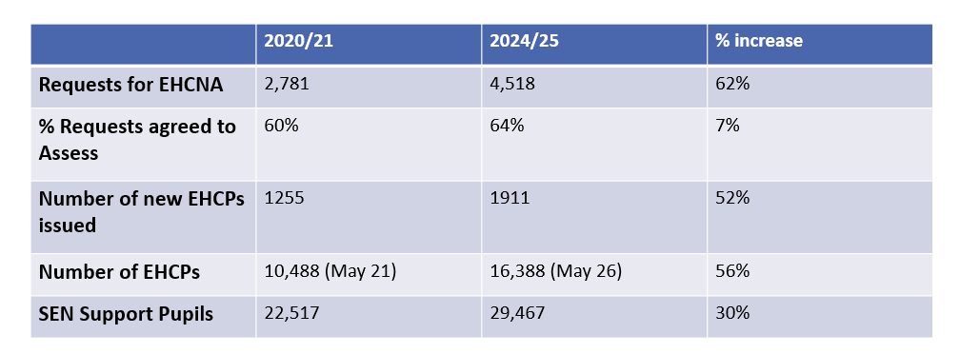
EHCPs: Process and Growth
EHCP Process
Request for EHCNA - Decision to assess (6 weeks) – multi-agency assessment – decision to issue an EHCP – draft – consultation – final EHCP (20 weeks total) – Annual Review cycle
Demand and growth
Sustained year-on-year increase in requests and EHCPs
Growth driven by:
Increased identification of SEND
Rising complexity of needs
Greater parental awareness and expectations
System pressures:
Capacity
Specialist placements
High Needs Block funding

Slide 21
SEND Inspection and SEND Reforms
Ofsted and Care Quality Commission inspected Ofsted in January 2026 – this is an inspection of Essex County Council and the Integrated Care Board
There are three outcomes – Essex received the middle outcome
“The Local Area Partnership’s arrangements lead to inconsistent experiences and outcomes for children and young people with SEND. The local area partnership must work together to make improvements”
Inspection Report can be found here: Essex SEND Inspection Report
The Department for Education are have just closed a consultation on their plans to reform the SEND system nationally
All local areas are expected to submit a SEND Reform plan by the 19 June 2026.

Slide 22
Home to School Transport (H2ST)
Scope of the service Home to School Transport is a statutory function transporting what are known as eligible children up to the age of 16 from a home address to school and back. Children are assessed against a statutory set of eligibility criteria that are based on their age and the distance to the school, whether a route is available to walk, and the impact of any special educational needs/disability. The statutory requirement is there to ensure children have access to school. The two main services are children in mainstream education and children attending schools for children with special educational needs and disabilities (SEND). Mainstream secondary transport is substantially delivered by buses; mainstream primary and SEND transport by minibuses. Cars are used when smaller numbers of largely SEND children are being transported either because of need, journey length or geography and where they represent the best value. There are also smaller services transporting young people from 16-18 years (which is a discretionary service) and children who are in alternative education provision (which is statutory). Transport costs are driven by people (drivers and Passenger Assistants), vehicles (especially accessible vehicles), fuel, insurance and specialist costs like cleaning. Essex has high levels of provision because of its rurality and scale (twice the size of Greater London).
Key Metrics: Schools & Colleges Served: 418 within Essex. 165 outside of Essex.
Mainstream H2ST: 9,288 children. 2026/27 budget: £14.9m. Largely delivered by buses (secondary) or minibuses (primary). | SEND H2ST: 4,937 children. 2026/27 budget: £53.1m. Largely delivered by minibuses and cars because of smaller numbers and longer distances
Operational Structure Services are substantially delivered through competitive tender by commercial providers (94 contracts). Children are assessed for eligibility within the Education service and transport services are managed in the Integrated Passenger Transport Unit within Highways and Transport. Services benchmark extremely well against other similar authorities for efficiency – often ECC is the best performer in terms of cost per child.

Slide 23
Education Finance
Dedicated Schools Grant (DSG) : Schools and early years providers receive their funding via the DSG. There are 4 blocks to the DSG
Schools Block – allocated per pupil via a funding formula which the LA passports on to schools. Option of approving through School Forum a transfer of 0.5% of funds through to any other DSG block (usually High Needs). DfE Secretary state decision if School Forum do not agree, or LA requires to transfer higher than 0.5%.
Early Years Block – To passport on Early Years Child Care entitlement funding, rising to 30hrs per week (over 38 weeks) from Sept 25 for those eligible from 9mth old to school age. The LA must passport on at least 96% of funding.
High Needs Block (HNB) – Educational funding for pupils with special educational needs including alternative provisions from early years, school ages, and post 16+ where the pupil has an EHCP Education Health and Care Plan.
Central Block – Split into ‘Ongoing Responsibilities’ (duties LA must carry out for all schools), e.g Director of Children/Education services, funding formula distribution, budget monitoring, school attendance, / admissions and ‘Historic Commitments’. For LAs with Historic commitments, the funding is winding down at rate of 20% each year.
School Forum:
A group consisting of representatives from schools, alternative providers, and early years settings who the LA works with on the allocation of the DSG at a local authority level.
DSG pressures:
Some maintained schools across the Essex Area have a deficit budget.
HNB – ECC currently have a year end deficit as do Thurrock

Slide 24
Dedicated Schools Grant / Maintained Schools
High Needs Stability Grant will provide additional government support for the financial years 25/26, 26/27, 27/28. the level for the 26/27 and 27/28 is currently unknown.

Slide 25
How members may become involved in Education services
All Councillors carry a general duty to safeguard and promote the welfare of children and should exercise their powers to support the local authority to develop effective service provision in this area
You may see / become involved in negative publicity about Education services
Constituents may approach you, they may be distressed, they may make complaints about services, about the way they may have been treated, about the decisions made by the Council and Partner Agencies; they may in some instances be justified, in others they may not
Constituents may complain that their child has not been offered the school want, or delayed education and health care needs assessment or refused transport; they may be concerned about their child experience at school and feel enough is not being done
You are likely to receive queries from constituents and will want to make Members Enquiries – often there are entirely valid legal reasons why the constituent has not received the outcome they want
Through Overview and Scrutiny Committees – you should question whether we are delivering effectively and improving outcomes for children

Slide 26

Questions
and Answers

Slide 27
Appendix

Slide 28
Schools, AP and Early Year Settings per District

Slide 29
Glossary
Academy – is a state funded school which is funded directly by the Department for Education and is independent of local authority control.
Free School – are essentially an academy. New schools built under the Free School Programme are funded by the DfE.
Maintained School – owned and maintained by local authorities.
EHCP – an Education, Health and Care Plan is a legal document setting out a child / young person’s special educational needs, the support they need and the outcomes they would like to achieve.
Dedicated Schools Grant – ring-fenced grant funded by the DfE.
Pupil Referral Unit – a type of school catering for children who are unable to attend mainstream schools.
Alternative Provision – education that a pupil receives away from school and arranged by the local authority.
Independent School – education establishment not funded or controlled by local authorities or central government.
Place Funding – core funding per each high needs place. £10,000 per place for Special Schools and PRUs and £6,000 per place for Enhanced Provisions.
Top Up – funding required above core funding to meet the needs of each pupil.
Special School – a school that specialises in special educational needs.
Schools Forum - a statutory body that serves as a channel of communication between local authorities and schools and has a consultative and decision-making role
EY – Early Years
PRU – Pupil Referral Unit
VAWG – Violence Against Women and Girls
SMC – Separated Migrant Children

