Slide 1
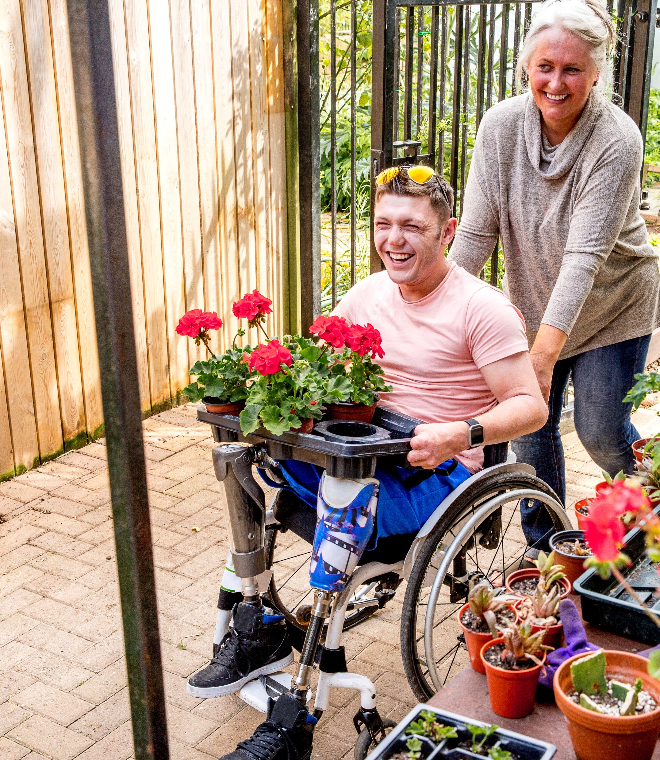
Adult Social Care
Member Induction Pack 2
Adult Social Care in Essex

Slide 2
  What is Adult Social Care?
Adult social care covers social work, personal care and practical support for adults over 18 years old with a physical disability, a learning disability and/ or autism, or physical or mental illness as well as support for their family carers.
Adults who cannot perform some activities of daily living such as washing, dressing, cooking, or shopping without support have care needs. These needs are often multiple and interrelated with other needs.
Despite the typical focus in public debate on older people, adult social care is much broader – indeed, ECC spends more on working age adults than we do on older people.
People may need help with:
People’s needs may be met through:
Personal care or nutrition
Keeping their home safe and clean
Maintaining family or personal relationships
Participation in work, education or volunteering
Using community services including public transport
Caring responsibilities
Care & support from family, friends or neighbours.
Local authority commissioned social services.
These are means-tested. Following financial assessment, the person may be asked to pay some or all of their care costs.
Private care services and support paid for by the adult themselves. (Self-funded)
Voluntary and community services
Notes:
.

Slide 3
Adult Social Care in Essex

Slide 4
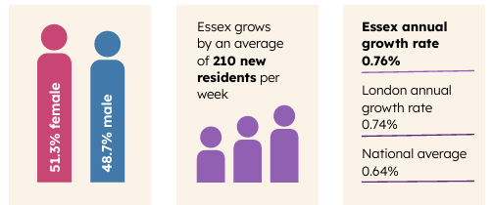
  Essex’s ageing and growing population
The population of Essex is 1.5 million and grew by 110,000 over the past decade.
One in five residents is aged 65+. The 70 to 74 age group grew by 44% in ten years (from 59,000 in 2011 to 85,000 in 2021).
There are 124,443 carers in Essex according to the latest Census in 2021. This is 8% of the Essex population. Many carers don’t identify themselves, so the real number is likely higher.
Deprivation in Essex is concentrated in specific areas. For example, in Canvey Island, Harwich, and Clacton 31% of residents live in acute deprivation.
Essex residents live longer than the national average, with a life expectancy of 79.9 compared to 79.1 nationally, but there is a significant gap in life expectancy between the most deprived and most affluent areas of Essex.

Slide 5
  Demand
ASC now has 16.3% more contacts and referrals each year than in 2019/20.
This is in line with our ageing and growing population.
While demand for Adult Social Care grows, we are focussing on ensuring we support people to remain at home and as independent as possible.
Our frontline operational workforce has been static since 2019/20.
The workforce is under pressure due to increasing demand and will struggle to meet future growth.
Our focus on supporting people to be independent has helped us mitigate this demand growth.
We have only seen a 4% increase since 2019/20 in long term care.
We are developing new ways to support our workforce and are monitoring team activity levels so we can support teams which complete less activity.
7.3% of older people who leave hospital receive reablement, compared to 5.7% nationally. This supports low residential care rate admissions (573 admissions per 100k people compared to 592 most recent nationally published data).
7.3% of older people who leave hospital receive reablement, compared to 5.7% nationally. This helps maintain low residential care rate admissions (450 admissions per 100k people compared to 592 nationally).

Slide 6
  How many people we support in Essex
At any one time in Essex we support between 17 – 18,000 people. This can be roughly broken down into…
10,000
5,000
2,000
1,000
Older People
Adults with Learning Disabilities and/or Autism
Adults with physical and/or sensory impairments
Adults with mental health needs
We also support around 4,000 carers.

Slide 7
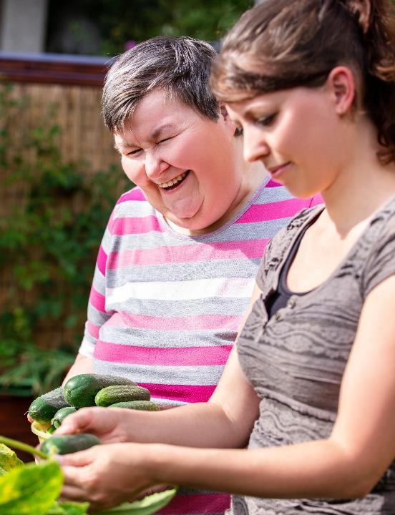
  Vision and Mission
Our vision: Enabling people to live their lives to the fullest
Our mission: Making the difference every day
The ambition is for people to enjoy:
Maximised independence and wellbeing
Choice and control over health and care
Access to a place called home
Access to social and employment opportunities
Positive experience of health and social care
Reduced inequalities and increased inclusion
People at risk can live free from abuse, harm and neglect
This focus on independence, wellbeing and safety enables the Council to fulfil its statutory duties under the Care Act 2014.

Slide 8
  ASC strategic goals and outcomes
The council's key strategic goals are built around helping people with care needs to live as independently and safely in their own homes for as long as they can and ensuring they have the support they need to promote their wellbeing and quality of life. By doing this, it is also contributing to the council's work around levelling up the county and enables the Council to fulfil its statutory duties under the Care Act 2014.
Adult Social Care Business Plan 2025-28 vison and objectives: People in Essex living their lives to the fullest
Financial Sustainability
Maximise Operational Capacity
Manage Demand
Improve Customer Experience
Supported, Happy Workforce

Slide 9


  Principles
Our principles guide the way we work.
Person-centred: we work alongside people to help them plan their support and achieve their aspirations.
Listening to residents: we listen to people with lived experience and base decisions in evidence and insight.
Prevent, reduce, delay: we identify and maximise opportunities to prevent, reduce or delay the need for care
Local: we make decisions as closely to residents as possible and encourage communities to play an active role.
Collaboration and coproduction: we work with a range of organisations and individuals to break down boundaries and work jointly towards shared goals.
Equality, Diversity and Inclusion: we promote equality, diversity and an inclusive culture within our own workforce, that of the care market and for the people we support.
Continuous improvement: we strive to always do better by finding new ways to improve outcomes.

Slide 10
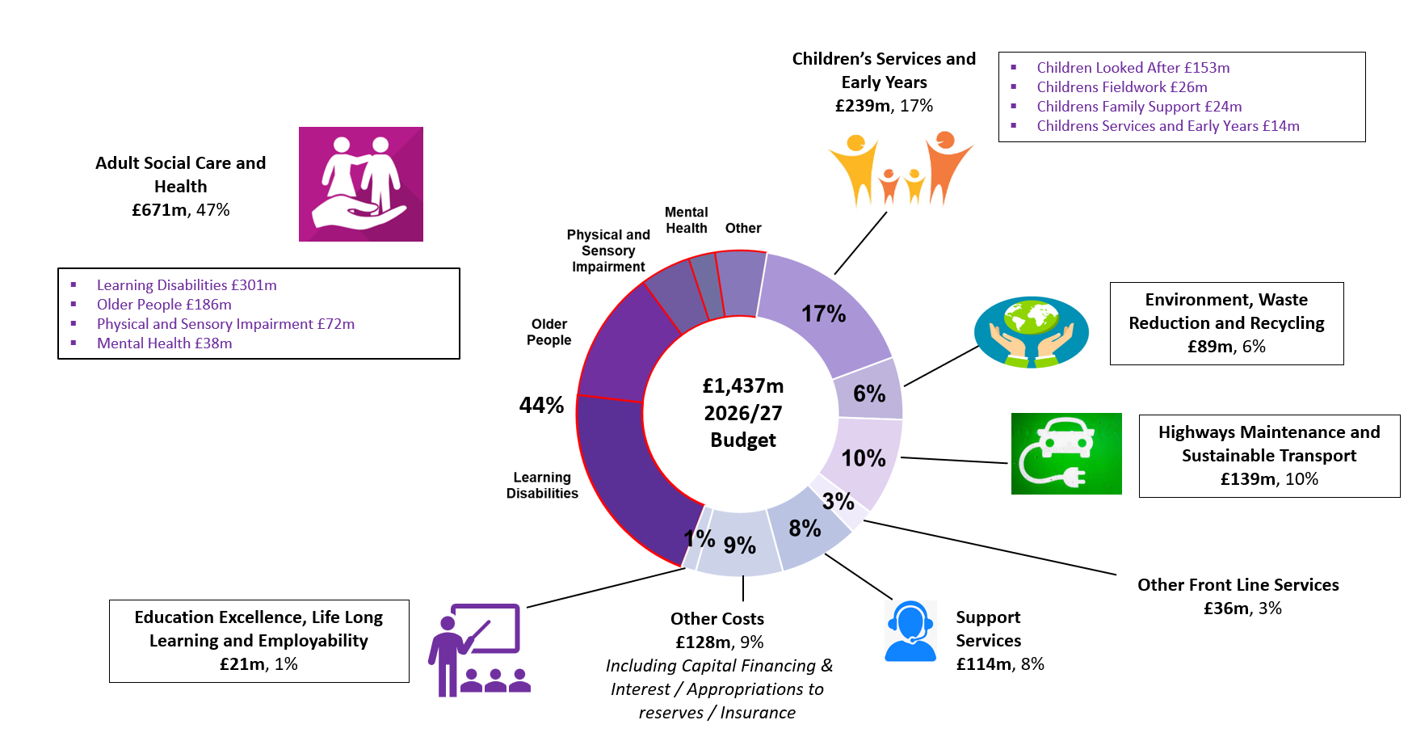
  Council budget allocation overview (data based on portfolio)
The 2026/27 ECC Revenue Budget (Net)
Adult Social Care is by far our biggest area of spend, at £671 million, 47% of the total council budget.
The largest areas of spend within this are learning disabilities (£301m) and older people’s care (£186m), reflecting both long-term, high-cost support and an ageing population.
The council’s overall financial sustainability is heavily dependent on managing demand and cost pressures in Adult Social Care.

Slide 11
  Assessments, Reviews and Safeguarding activity
Assessments
In the 12 months to June 2026, ASC received 16,805 requests for an assessment.
We currently have 951 people waiting for an Assessment. The average wait for an assessment to start is 20 days with 73% of all assessments starting within 28 days.
Safeguarding
ECC received 28,000 safeguarding concerns in the last 12 months – a 57% rise in safeguarding alert demand over the last 24 months.
In the 12 months to May 2026, ASC started 7,500 Safeguarding Enquiries (a 22% rise on the 12 months to May 2025).
Adults already in services require a Review once a year
ASC supports around 17,500 people with long term care at any given time. Adults who receive a service for 12 months or more (after their last assessment/review) require a Care Act Review.
ASC complete around 29,000 reviews a year, a significant amount of which are for adults whose care needs have changed and who need an urgent, unplanned review.

Slide 12
  Essex Residential Care Market
Mental Health Residential & Nursing Care
Older People Residential & Nursing Care
212
60% Good or Outstanding
238 ECC funded adults
75% Good or Outstanding
2,942 ECC funded adults
20
Working Aged Adults Residential & Nursing Care Homes
Older People Nursing Care
71
161
72% Good or Outstanding
736 ECC funded adults
81% Good or Outstanding
1,104 ECC funded adults
Data source: Market Position Statement report April 2026

Slide 13
  Essex Care in the Community
410 Domiciliary Care Providers
87% rated Good or Outstanding
7,296 Adults placed by ECC
1,842 Supported Living Units
77% rated Good or Outstanding
1,472 Adults placed by ECC
1,686 Adults using
Day Care services
2,415 Adults using
Direct Payments
695 Extra Care Units
71% rated Good or Outstanding
340 Adults placed by ECC
Data source: Market Position Statement report April 2026

Slide 14
  Lived Experience
We are capturing and using adults voice and experience alongside other performance data to help us to understand how well we are doing and where we need to improve – we do this through:
Guided telephone interviews with people using our services to understand their experiences.
Working with people with lived experience on making improvements to existing services and shaping new solutions.
Surveys accessed via a QR code, which is placed on all our communication to citizens.
Some of the changes we’ve made from what we’ve learnt include:
Improved accessibility of information in adult social care and GP surgeries.
Improving people’s experience of social care reviews.
Coproduction of the new all-age autism strategy with autistic people and their families.
New lived experience videos showing the challenges and barriers people face accessing pharmacy services are now used in pharmaceutical training across Essex.

Slide 15
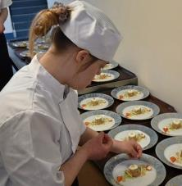

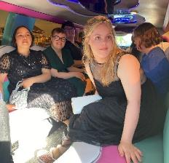
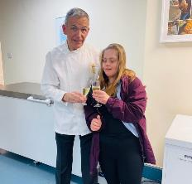
Katie’s Story: Transitions
Prevent
Enable
Support
Katie is aged 25 and has Down’s Syndrome and a learning disability.
She attended College where she enrolled in a Hospitality and Catering course.
Katie strengthened her independence skills and confidence by engaging in themed nights and mentoring younger students.
Katie participated in Travel Training which enabled her to feel confident travelling to college and accessing local facilities.
In July 2024, Katie completed her NVQ and graduated college.
Following college, Katie secured part-time employment.
Guidance was provided by an Employment Coach from the Inclusive Employment Team.
Access-to-Work funded travel support from home to the employment.
Katie plans to move into supported living accommodation with support from the TEC Team.
This will provide Katie with independence and her family peace of mind.
Katie is very happy and is excited about her new chapter in Essex.

Slide 16
  Complaints
People using Adult Social Care can raise Compliments or Complaints via our Have your Say system. In 2025/26, Adult Social Care received 912 complaints – this is a 12% rise on the year before. In the final quarter of 2025/26, we received 219 complaints and resolved 208 (the balance are still being responded to). Of the 208 resolved complaints in Q4, 49% were fully or partially up-held. On average Complaints are responded to in 19 days.
In addition to the statutory and corporate complaints process, ECC runs a Member Enquiries service, and replies to Local Government Ombudsman requests. We monitor themes within our complaints, compliments, Member Enquiries and Local Government Ombudsman cases which helps inform service improvements.

Slide 17
Why do people complain?
  Why do people complain?
*Based on refreshed May extract of the Q4 complaints data.
ASC uses complaints data to provide service assurance and improvement. Working with our Corporate colleagues in the Complaints and Compliance Service, we regularly analysis the volume and nature of complaints. The below table is taken from recent analysis of complaints received and resolved in quarter 4 of 2025/26.
What do each of these categories mean:
Complaints about Social Care Practice, Assessment, Care Planning and Eligibility and Review/Continuity of Support will predominately relate to how Social Care Practitioners complete assessments or reviews, and/or how care and support is structured.
ASC services are subject to an assessed weekly charge. Complaints about Financial Decisions and Charging relate to the process of ascertaining the persons assessed weekly charge, or the way in which they are billed for their contribution.
Where care visits from providers are poorly coordinated, care needs are not met, or there are specific concerns about the conduct of providers put in place by ECC, complaints will be logged as relating to Care Provider/Service Delivery and Oversight.

Slide 18

Care Quality Commission Assurance 2025

Slide 19
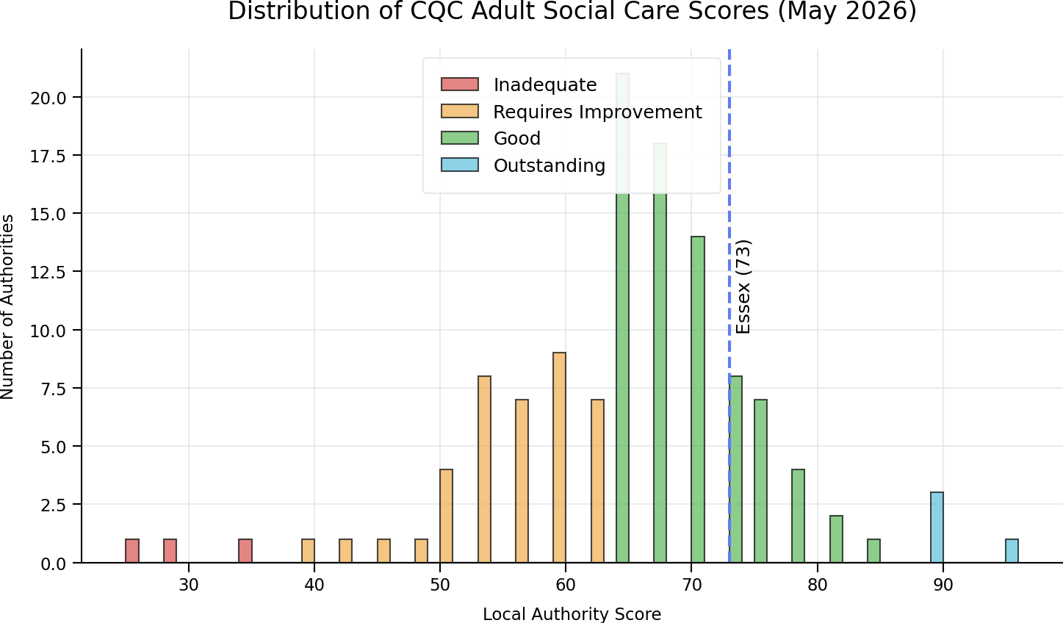
  Essex is rated “Good” by CQC
“The local authority had good structure and processes in place to enable people to be supported successfully, and support people to remain independent and live healthy lives.
The workforce was passionate about supporting people to achieve these outcomes and the local authority had good knowledge of their area, the people living there and the demographics”
121 Local Authorities Adult Social Care services have had published reports as of the 15th of May 2026.
Essex’s score of 73 shows a strong performance position, which is within the top quartile of all assessed councils.
You can read the full report here.

Slide 20

  Our CQC Assessment Report
Key Strengths
Person-centred, focussed on early help, prevention and reablement
Peoples wishes were taken in to account including good access to advocacy.
Positive hospital discharge outcomes, enabling return home or to community settings.
Understanding needs in communities to support outcomes for people.
Effective safeguarding Systems and Processes
Protecting people from abuse and neglect, with strong collaboration with ESAB.
Leadership, culture and working with Partners
Stable and clear leadership with robust governance, reporting systems, and effective communication.
Strong partnerships with providers, partners, and stakeholders.
Inclusive culture of learning and improvement.

Slide 21
  Our CQC Assessment Report
Key Areas of Improvement
Assessments and Reviews
We need to reduce delays in assessments, reviews, financial assessments and DoLS.
Increase workforce knowledge of financial assessments and improve information and advice for adults.
Carers
We need to support carers to receive regular carer assessments.
Ensure our support offer to carers has improved access and choice of services.
Further embed contingency plans for carers.
Safeguarding
Some partners found it was hard to contact teams for outcomes on referrals.
Some providers found guidance unclear on when/how to raise a concern.

Slide 22
  Our major challenges
Growing Demand
Growing and ageing population; greater complexity of need; economic factors.
Financial pressures
Funding struggling to keep pace with demand; national uncertainty on funding.
Workforce
Recruitment and retention a challenge for the sector.
Mental Health
Increasing demand, exacerbated by the pandemic and cost-of-living challenges; challenges with mental health assessments, inpatient support and supporting people out of hospital.
Local Government Reorganisation (LGR)
There are significant implications arising from LGR for ASC, we have commenced work to understand theses implications and start to prepare. ​

Slide 23
Where to go for information and queries

Slide 24
  How we support residents
There is a wealth of information on our website www.essex.gov.uk/topic/adult-social-care-and-health
about different kinds of support available to meet a range of needs including:
Help with meals and shopping
Adaptations for your home
Equipment to stay independent
Technology for independent living
Walking and mobility aids
Preparing for going into and leaving hospital
Paying for care and support
Support for carers
Visit: Local support for carers | Essex County Council
We know that a high proportion of carers are supporting a person with dementia. Along with our Southend, Essex and Thurrock Dementia Strategy 2022 to 2026, you can find out more about the support available via the Alzheimer's Society.

Slide 25

  Key contacts
Adult Social Care:
    Telephone:
    0345 603 7630
    Textphone:
    0345 758 5592
    Monday to Thursday: 8.45am to 5pm
    Friday: 8.45am to 4.30pm
    Emergency Duty Service
    (for out of hours queries):
    0345 606 1212
    Email:
    socialcaredirect@essex.gov.uk
The Essex Wellbeing Service supports people in the community and at work with a range of health, wellbeing and day to day needs.
They also coordinate requests and referrals for everyday tasks and connect people to volunteers.
Website: www.essexwellbeingservice.co.uk
Telephone: 0300 303 9988

Slide 26
  Member enquiries team
Role & Purpose:
Single point of contact for all County Member and MP enquiries
Work with internal services and external partners to gather information and provide responses
Response Times:
Standard response time: within 10 working days
Aim to respond as quickly as possible
Priority Handling:
Urgent enquiries are prioritised over routine cases
Examples include:
  Social care matters
  Flooding
  Dangerous potholes
Urgent Contact Numbers
Highways: 0345 603 7631
Children and Families Hub (safeguarding): 0345 603 7627
Social Care Direct (adult concerns): 0345 603 7630
How to submit Enquiries
Online: Member Enquiry Form
Email: member.enquiries@essex.gov.uk

