Slide 1
Members Highway Initiative – Members Briefing

Slide 2
Agenda
1
Introduction (Cllr Cunningham) (5 mins)
Focus for Members Highway Initiative- What are we covering today?
2
Member End to End Process (Julia Kerr) (20 mins)
3
Member Portal Improvements (Jo Fletcher/ James Atherton-Gower) (10 mins)
4
Q & A - All (Cllr Cunningham, Julia Kerr, Jo Fletcher / James Atherton-Gower) (25 mins)

Slide 3
Introduction
Cllr Tom Cunningham

Slide 4
Focus for Members Highway Initiative
Allow ECC to allocate resources to fix defects which currently don’t have a timescale for repair.
Will enable Members to prioritise which existing defects, or areas of defects, are repaired first within their divisions
Defects to be covered in the process:
        Carriageway Defects; Permanent repair to either single or clusters of defects.
        Footway Defects; Permanent repair to footway or kerb defects.
        Street Furniture Defects; Replacement of unlit sign faces, posts, bollards and guardrail defects.
        Iron Work Defects; Replacement of damaged gully covers and frames.
        Enforcement of overgrown vegetation on private land affecting the Highway Network.
        Enforcement of ditch maintenance on private land.

Slide 5
Focus for Members Highway Initiative
Resource is allocated fairly across the county for Members Highway Initiative activity. All Members will be allocated, in advance, a 1 week slot once every 6 weeks throughout the year
Members nominate tasks in the public interest to repair existing defects.
When a Member hasn't provided a submission of works for their division, the allocated crews will repair previously identified defects in that area for the week.

Slide 6
Members Highway Initiative – End to End Process
Julia Kerr

Slide 7
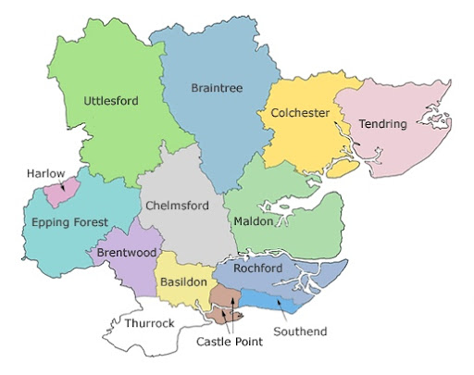

Essex Highways Working Crews
9 Crews working across 12 Districts
2 Crews Iron Works & Signage
1 Crew Catch up/Over-run
Enforcement team resource has been added to look at issues raised including private vegetation affecting the network, enforcement letters and blocked ditches
Each Member will have 6 slots of work allocated throughout the year
Members will have up to 4 weeks BEFORE their submission window to gather information to add to the portal

Slide 8
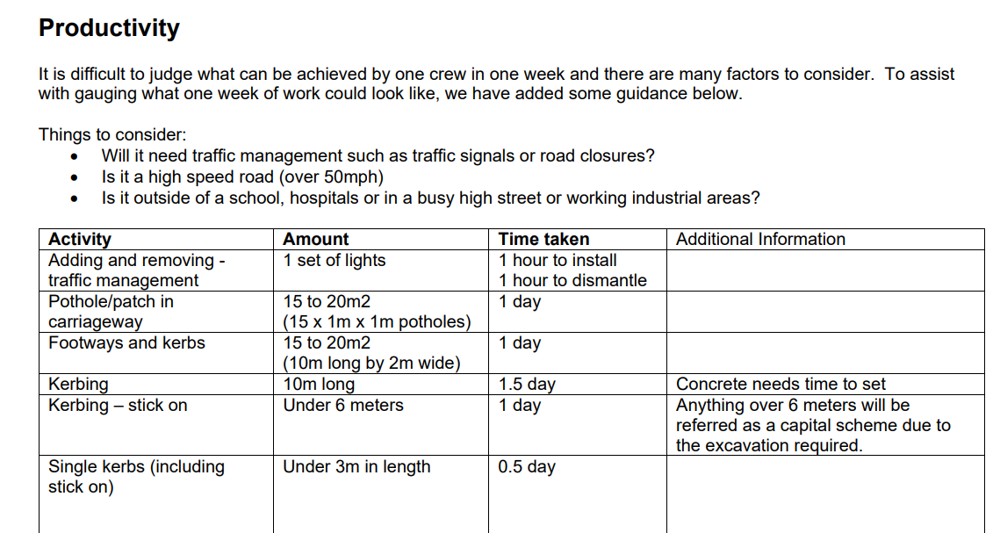
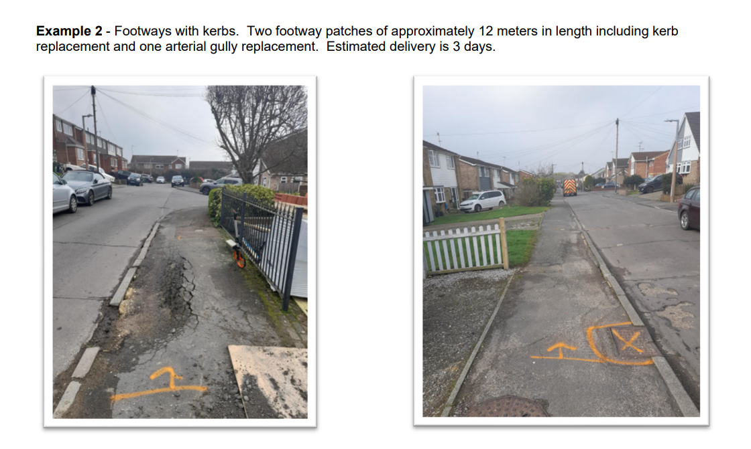
Members Highway Initiative – Guidance Document
Essex Highways will provide a reference document for Members to gauge what can be done in a week to help with submissions, and to help Members provide submissions for their window. This will be issued after this presentation.
Members need to submit a week’s worth of work and can identify a priority for that week, examples and instructions will be in the document.

Slide 9





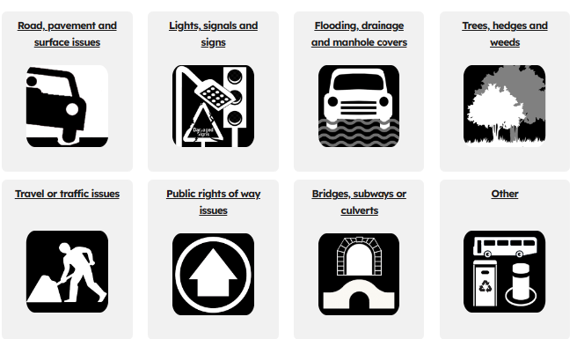
Members Highway Initiative - 4 Key Steps
The Members Highway Initiative process has four key steps outlined below:
Step 1: Submission - Member Review Defects and Submit via Portal
Step 2: Triage - Essex Highways Review submissions
Step 3: Programme -Essex Highways Schedule Works
Step 4: Works - Essex Highways Repair Defects

Slide 10
Submission Process
Members will have a 1 week slot every 6 weeks, allocated in advance for 2024-25. These will be issued after this briefing.
At least 5 weeks before your due date Members will need to submit their defect list for their allocated slot. Members will be prompted via email to submit prior to the window
Members will receive a list via email of the top defects in their area. The portal will be used to submit the defect list in the same way a new submission/defect is logged today.
Members will also be able to log on to the Portal and view a map of their area, look at defects on their list, as well as view every road in their Division.
Once a defect is raised via the portal, Members will get an email response with a reference number to be able to track the defect through the portal
Essex Highways will share a webpage link shortly for Members to view their windows with submission dates. It would really help if Members in the early phase of the project can submit some issues as soon as possible after this briefing concentrating on carriageways.

Slide 11
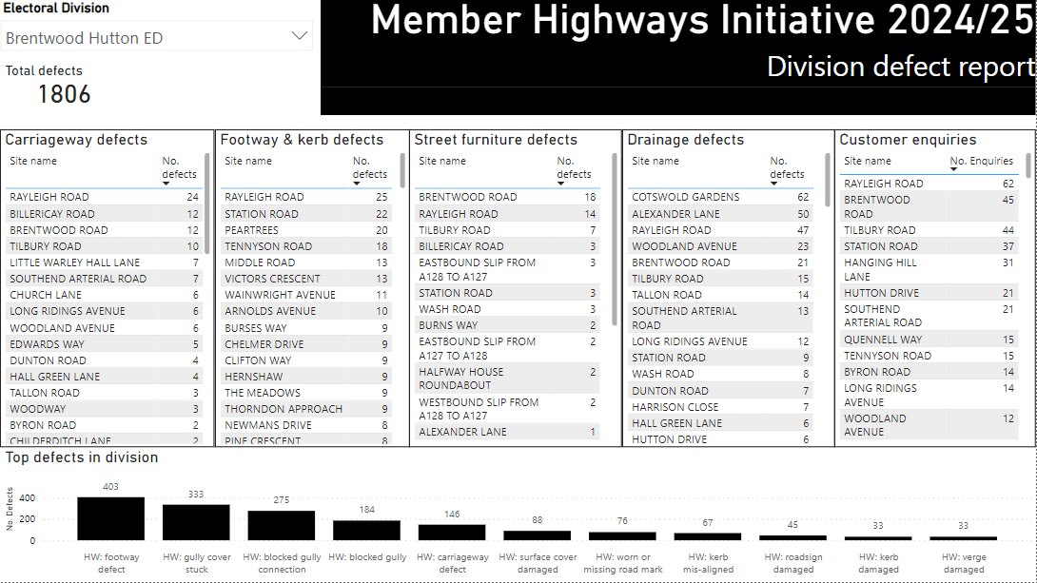
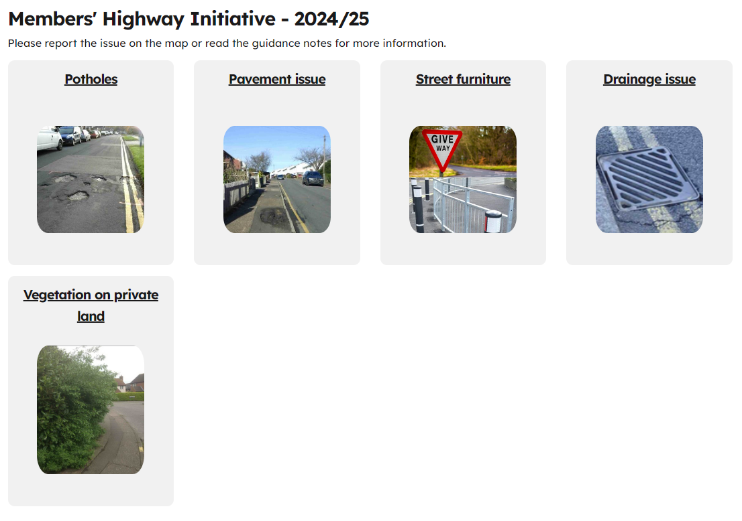
Submission Process Example report and input screen

Slide 12
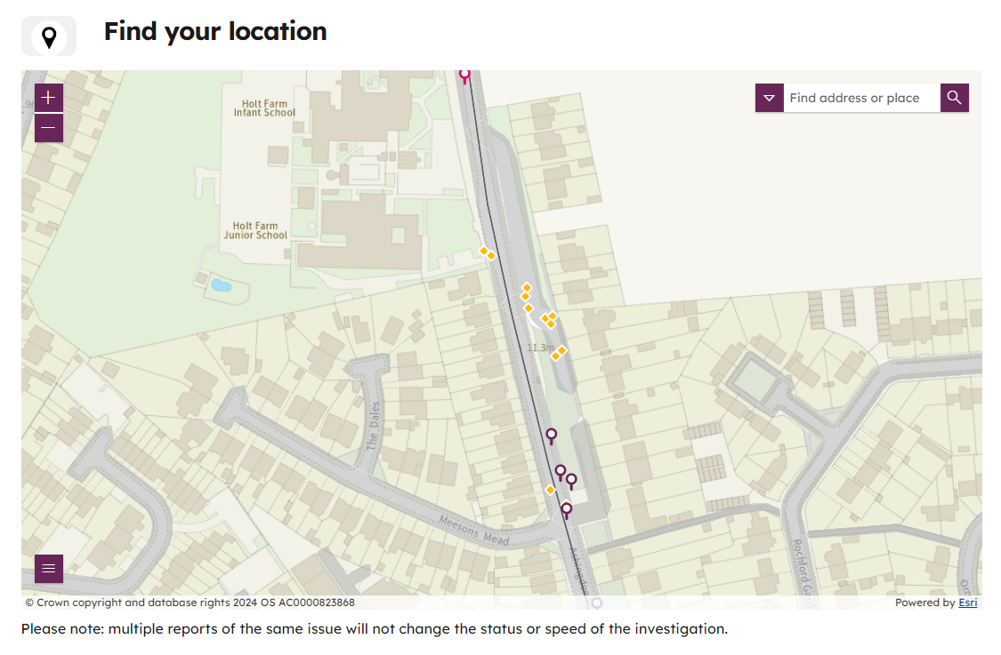
Submission Process
The submission map will display existing defects and customer enquiries.
Use this to aid your site selection choices.

Slide 13
Triage process
Essex Highways will initially triage submissions so that the Member can understand the complexity and likely timescale. This will be based on RED / AMBER / GREEN status:
    Green – straightforward request; will be scheduled for work in the next available slot in your division.
    Amber – requires some planning / more complex traffic Management. Works will take place in the medium-term e.g. 12 week lead in time for road closures, anything requiring night works, PR1 network (restricted working hours).
    Red – Needs longer-term planning and complex traffic management to be scheduled. Will be delivered under this programme but in the longer-term e.g. any works linked to National Highways or Network Rail restrictions, locations close to development management schemes, works requiring collaboration with other local authorities.
There is also a Rejected status, Submissions can be rejected because:
    A capital scheme is imminent
    Existing job is already planned via Maintenance team
    Out of scope (examples include concrete roads, concrete footpaths, not our asset, excessive scope of work, anything requiring electrical work). Please refer to guidance document for further examples.
Members will get the Triage status communicated to them via email. And this status will be shown on the Members portal against the defect raised

Slide 14
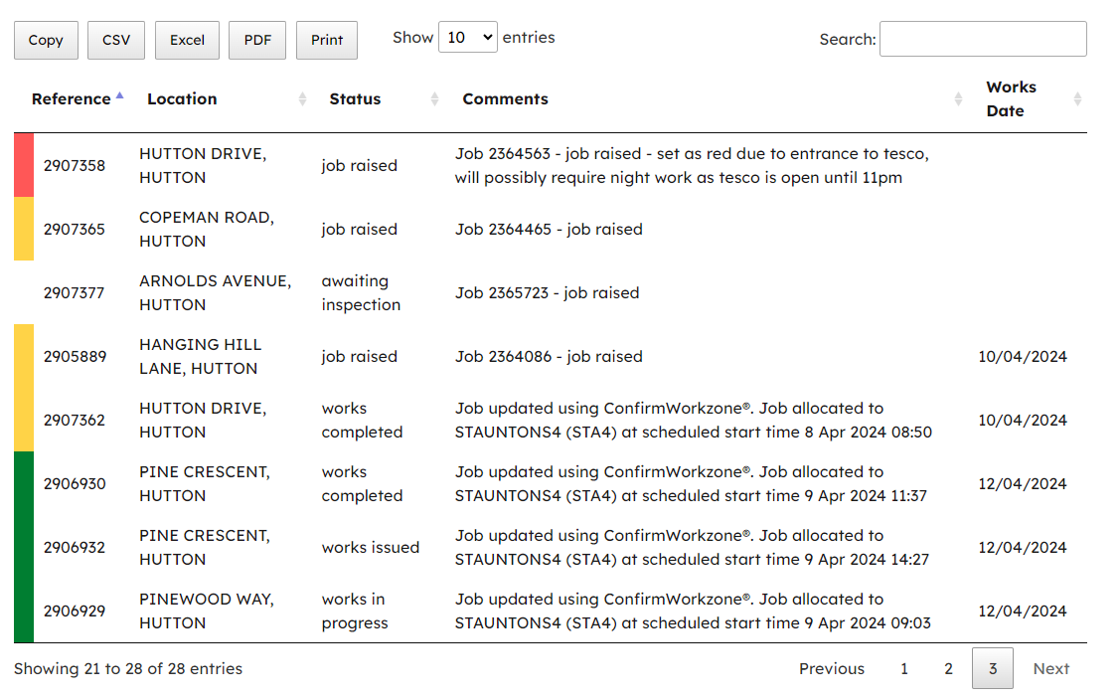
Triage Process – Members Page

Slide 15
Programming Works
Essex Highways will allocate work via the normal process. This sees the programming of works, permit applications, road closures and allocating to crews
Once a permit is authorised a date will be allocated to the job. Members will receive an email confirming the date of works, and the portal will be updated.
Normal caveats apply to planned works. Jobs can be postponed due to weather or unforeseen incidents such as immediate permit applications from utilities, including service interruptions. This will be updated in the comments section of the Members Portal, so Members can track and read communications should any dates change in the portal. We don’t see this as being significant numbers.

Slide 16
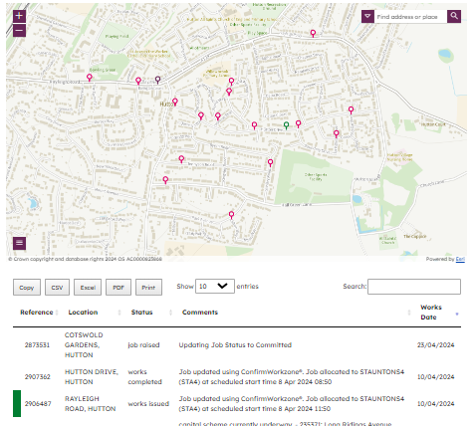
Programming works
Members will be able to log on to the portal and view a map of their area and defects will be shown on their defects raised and planned works date and triage status
Dear Cllr,
Please be aware Essex Highways crews are expected to be in your division [next week / specific dates] carrying out repairs. They will be fixing issues in [insert location details] which you reported as part of the Member Highway initiative.
You will be able to access live updates from the Members portal on the Essex Highways website.
Regards
Member Highway Initiative Team

Slide 17
Defect Repairs – Completion of works
Essex Highways crew will attend site for the jobs raised in the week of works
Where possible all works will be completed on dates shown on portal. If any issues arise; such as snagging or over-runs, then these will be picked up by the spare crew in the weeks following.
Once the jobs are complete the portal will be updated and the Member will receive an email to confirm.
Dear Cllr,
We can confirm that the following works [enter location/s detail] have now been completed by Essex Highways. We will write to you informing you of when you can next submit defects for consideration as part of the Member Highway Initiative.
In the meantime, you can access live updates of works happening in your division from the Members portal on the Essex Highways website.
Regards
Member Highway Initiative Team

Slide 18


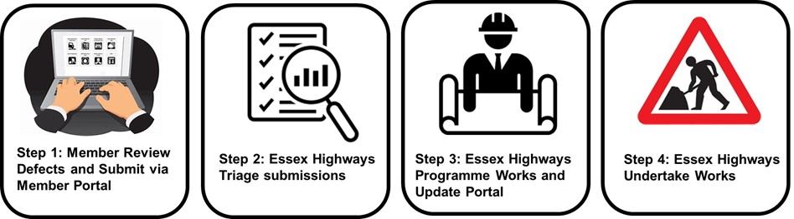
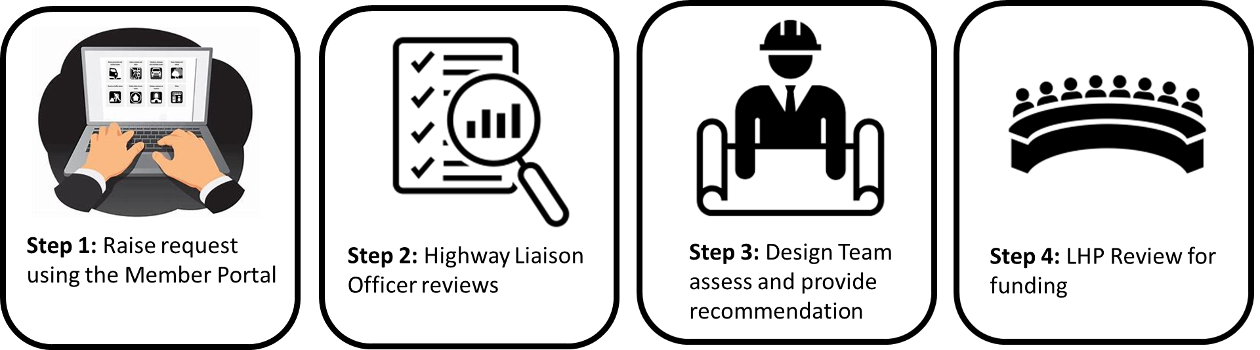
Members Highway Initiative – Communication
The Member portal will track progress via the tracking dashboard available. EH will also email updates at stages in the process:
Tracking Dashboard: Updated after each step – access via Member portal
Step 3: Design Team assess and provide validation

Slide 19
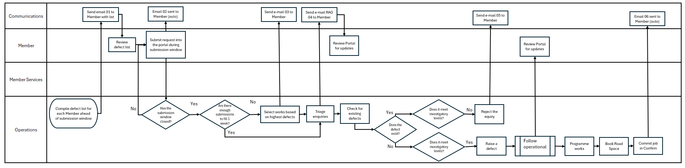
Detailed End to End Process

Slide 20
Members Portal
Jo Fletcher

Slide 21
New and improved webpage for Members
The Members portal on the Essex Highways website has been updated and improved to provide more information and a better experience for Members to find out what works are happening in their areas.
Tabs along the top of the screen will guide you to the information you require
In addition to submitting Members Highway Initiative requests, you can:
View upcoming works for the next two weeks
View previously reported defects and their status

Slide 22
How to log on
Visit www.essexhighways.org/members-update-page.
Enter your email address, which will generate an email to you with a verification code.
Enter this code on the webpage.
You will only need to do this once on each device you use.

Slide 23
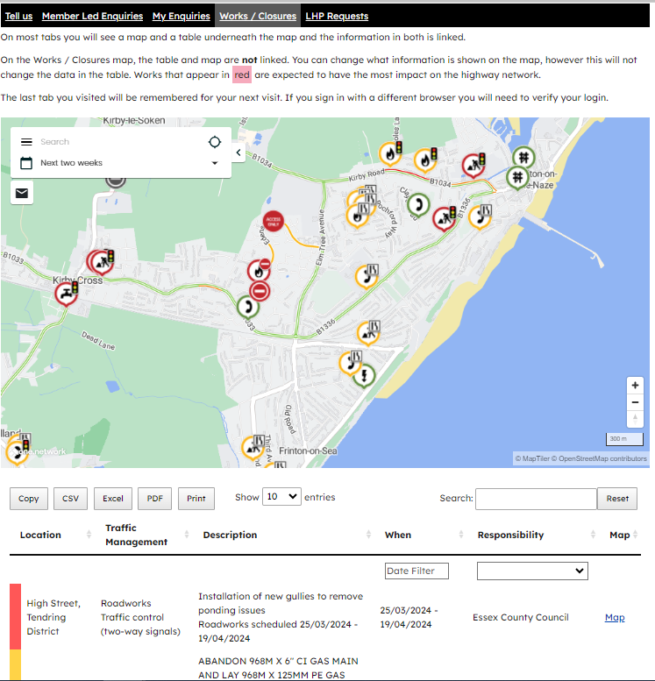
Viewing upcoming works
Works & Closures tab:
The webpage includes a tab with live updates of works happening in your division over the next two weeks.
Map shows the data for each area and you can zoom in and out
There is also a separate table below that can be exported and download in various file formats for you to view on phone/laptop

Slide 24
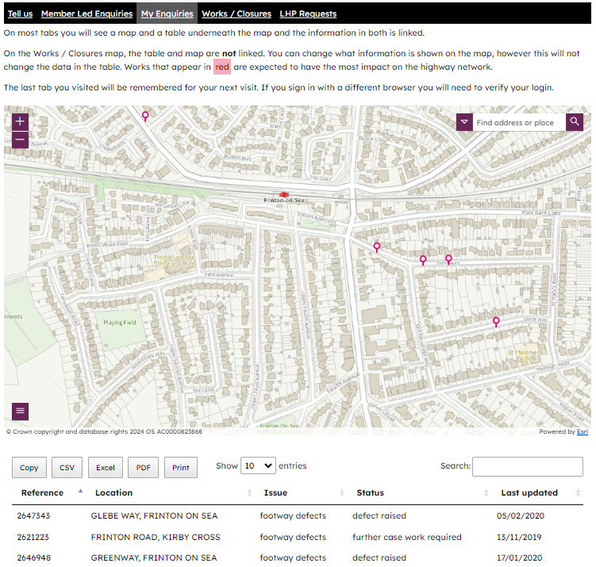
Previously reported enquiries
My enquiries tab:
Map details personalised enquiries – subscribed or reported
Excludes previous reports via Member Highways Initiative scheme 2023

Slide 25
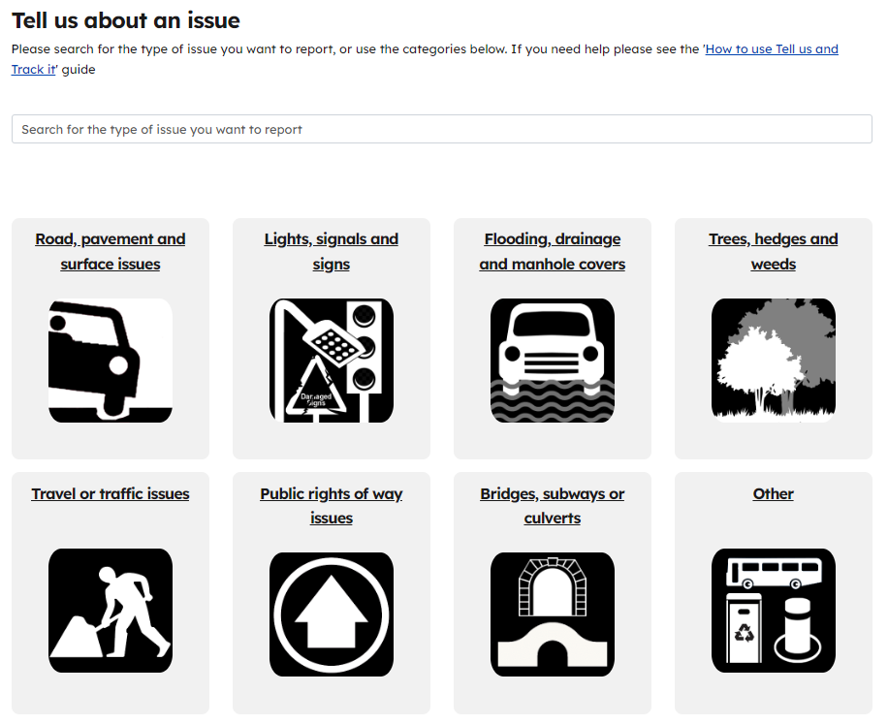
Submitting an enquiry outside the Members Highway Initiative
Tell Us is still available for enquires that are outside of the Members Highway Initiative
www.essexhighways.org/tell-us

Slide 26
Ongoing Support for Members Highways Initiative
Instructions will also be available on how to use each tab on the Portal. This will help guide Members through the tabs available on the portal
Members will receive a link to the webpage with instructions on how to log on. A guidance document for submissions for the Members Highway Initiative will also be received showing examples of defects to report
Regular emails will be provided through the Members Highway Initiative and Members will be able to track and self serve submission via the Portal
The team will offer dial in teams' session on the process to discuss this presentation, the end-to-end process and Members portal. We can also arrange one on one sessions if required. Please Contact - Deborah.Townsley@essex.gov.uk with your enquiry
All Member briefing in May as required to feedback experiences and capture and explore Member suggested changes to the process, building on pilot and early experiences

Slide 27
Question & Answers please

Slide 28


This information is issued by: Essex County Council
Contact us:
karina.grimwade@essex.gov.uk
Essex County Council
County Hall, Chelmsford
Essex, CM1 1QH
Essex_CC
facebook.com/essexcountycouncil
The information contained in this document can be translated, and/or made available in alternative formats, on request.
Published 25/03/24

