Slide 1
Member Allowances,
Expenses and ePayroll for Newly Elected Members
A Practical Guide

Slide 2
Context
The Council sets allowances, but must consider a report from an independent renumeration panel before changing them
The most recent full review of allowances took place in 2022
Annual Indexation applies in accordance with the Constitution

Slide 3
Member Allowances Scheme
Approved Duties
Approved duties are defined in Appendix 1 of the Member’s Allowance Scheme
Basic Allowance (BA)
£14,471 per annum for all members
Paid to members with additional responsibilities (e.g. Cabinet, Scrutiny Chairs)
Travel costs may be claimed only for Approved Duties and in accordance with the Scheme
Travel Expense
Special Responsibility Allowance (SRA)
Subsidence Expense
Dependent Carers Allowance
Hospitality
Paid monthly, normally on or just before the 23rd of the month
For approved duties undertaken at locations outside of the County of Essex
In exceptional circumstances members may be in a position where they are required to provide hospitality.
Members with care responsibilities will be reimbursed for reasonable payments to a carer while the member is on approved duties.
The need for incurring such expenses must be approved in advance by the authorising officer.
No payment will be made with respect to care provided by a carer who is a member of the claimant members household.
Most commonly only apply when attending conferences
Expenses can only be claimed for approved duties
Details and rates are set out in Appendix 2 of the Member’s Allowance Scheme
Recognises the time you spend as a Councillor and incidental costs
Part 5 of The Constitution
Notes:
This will be paid into the bank account you provide us and will be paid on 23rd or working day closest before 23rd each month
All members receive £14,471 per year and is paid in instalments on a monthly basis, usually one twelfth of the amount, although for new members you first payment will be made in the June pay run for your amount for May and June. The amount of the allowance is intended to recognise the time you spend and incidental costs.

Slide 4
Allowance Scheme
Basic Allowance
£14,471 per year for all Members
Special Responsibility Allowance
Paid in addition to the Basic Allowance
Calculated and paid in line with Appendix 2 of the Member’s Allowance Scheme
Notes:
This will be paid into the bank account you provide us and will be paid on 23rd or working day closest before 23rd each month
All members receive £14,471 per year and is paid in instalments on a monthly basis, usually one twelfth of the amount, although for new members you first payment will be made in the June pay run for your amount for May and June. The amount of the allowance is intended to recognise the time you spend and incidental costs.
In addition to the basic allowance there are special responsibility allowances for those who have additional duties deemed over and above the basic allowance, these are worked out as a multiplier of the basic allowance for all cabinet and then a percentage of the leaders allowance for other positions. They are all set out at appendix 2 of the MAS

Slide 5
Making an expense claim: what you cannot claim:
Constituency duties as these are already covered by your Basic Allowance
Political activities, including coming to County Hall for your group meetings
Expenses where you are paid or reimbursed by another organisation
Broadband, telephone bills or other telephony costs
Stationary (paper, ink, envelopes, stamps, pens etc.) You must purchase these items yourself and they should not be taken from the council offices
If something is covered by your Basic Allowance or excluded by the scheme, then it cannot be claimed as an expense. If you are unsure – please ask.
Notes:
In addition to your basic allowance there are approved duties that you can make expense claims for. We are going to take you through how to make a claim, however we will now set out what you cannot claim.
So the 12000 covers divisional or constituency duties, so if you are undertaking business in relation to your division these are considered to be covered as part of your basic allowance, although appendix 1 of the MAS sets out in details approved duties where you would be able to make a claim. That said, if you attend a town or parish meeting as the local county member you are able to claim for that.
You cannot claim for any political activities, including if you came to county hall purely for the intention of a political group meeting.
If you receive payment from another body you cannot then claim from ECC, some outside bodies allow expenses, you cannot claim for both
We make no payment for telephone bills, internet etc, although we can assist you with equipment, your basic allowance covers these costs. This also for any stationary you have, although we will arrange stationary such as business cards for you if you desire.
Anything you pay for that is not within the allowance scheme cannot be reimbursed by expenses.

Slide 6
What you can claim:
You can claim reasonable expenses only where they:
- Relate to an ‘Approved Duty’ as defined in Part Five, Appendix 1 of The Constitution
- Are incurred wholly, exclusively and necessarily in carrying out Council business
Notes:
So, in essence – you can claim for the list of approved duties as per appendix 1 of the member allowance scheme
The detailed paragraphs and sub-paragraphs of those definitions can be broadly summarised as duties undertaken on behalf of the County Council

Slide 7
Some examples are:
Travel expenses incurred to travel to and from a place of work to undertake an Approved Duty;
Mileage by car or other vehicle (including bicycles) ,
Public transport fares,
Taxis (in very exceptional circumstances)
Subsistence (capped to specific amounts and only when the expense is incurred outside of the county of Essex)
Dependent Carers’ Allowances
Some specified professional fees
Notes:
What you can claim, some examples – travel to county hall
Subsistence when on approved duties outside of the county of essex and as per the scheme for amounts and times, please note, alcohol will never be reimbursed.
If you have caring responsibilities for children under 16 or dependent adults as certified by a doctor of social worker when you are on approved duties and
Some training events and courses if you apply and it meets the needs of your role may be claimed, but talk to us first.

Slide 8
A simple test
Is this something you are doing on behalf of Essex County Council (ECC) or are representing ECC at?
Is this listed (or clearly fits) within Appendix 1 of the Member Allowances Scheme?
Are you being paid elsewhere for it?
If unsure – ask before claiming.
Notes:
So you can claim for public transport – we understand about Dartford crossing and Oyster payments, please speak to us and we can help
Where possible we need receipts, this could be a photograph or screen grab from your smart phone
You must take advantage of cheapest fairs, we will not reimburse for first class
If you are going outside of Essex to a meeting, please let us know we can organise travel tickets in advance taking advantage of cheaper rates

Slide 9
More about making claims for travelling expenses.
You can claim for travel by public transport on a train or by bus – but by taxi only in exceptional circumstances (speak to us first).
You can also claim for parking and for Oyster Travel. But all such costs will be reimbursed at cost and only on production of a receipt attached to the claim.
You must take advantage of the cheapest available fare.
There are special arrangements for journeys outside Essex or London – these are normally booked in advance through officers of ECC and are not claimed after the event.
Notes:
So you can claim for public transport – we understand about Dartford crossing and Oyster payments, please speak to us and we can help
Where possible we need receipts, this could be a photograph or screen grab from your smart phone
You must take advantage of cheapest fairs, we will not reimburse for first class
If you are going outside of Essex to a meeting, please let us know we can organise travel tickets in advance taking advantage of cheaper rates

Slide 10
Air Travel and Travel Abroad
Like rail travel outside of Essex and London, all air travel must be booked in advance by officers. This takes advantage of our contracts with travel providers.
Air travel is only permitted in certain circumstances, where (for example) it avoids the need for an overnight stay, or is cheaper than alternatives.
The air travel booked by officers will be economy class.
However - most importantly – if the travel (by any means) is beyond the borders of the UK it must be approved in advance – seek advice.
Notes:
We have special arrangements for air and foreign travel including a foreign travel committee. If you need to travel abroad talk to us ASAP.

Slide 11
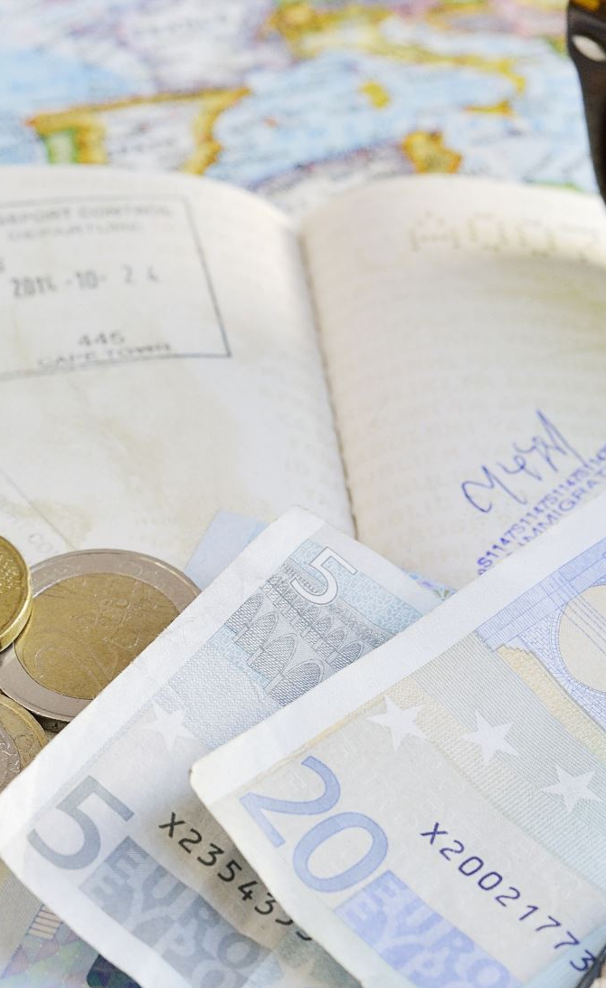
Significant cost or overseas travel
Wish to attend external training or conference – complete this approval form Member Development Nomination Form (external bookings)
If it meets any of the following:
- Any overseas travel
- Any trips that include councillors and where total cost (including conference/accommodation/travel expenses) is more than £500 for one councillor or more than £1000 if more than one councillor travelling
- Where any officers and members are both attending and total cost is more than £500
A form for approval of high cost or overseas travel needs to be completed and approved New Request for Approval of For High Cost or Overseas Travel

Slide 12
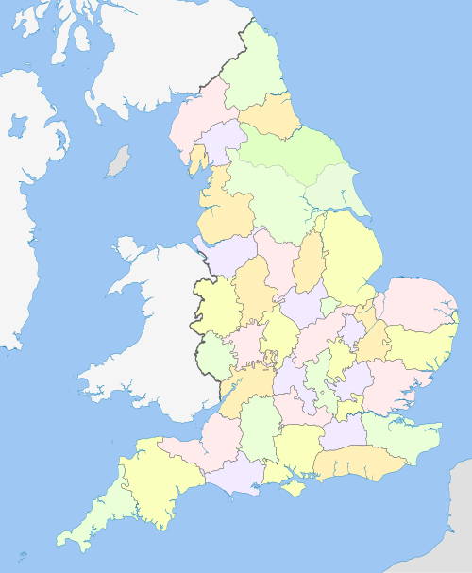
Subsistence
Breakfast (starting before 7:30am) £5.00
Lunch (12 noon to 2:30 pm) £10:00
Dinner (ending after 8:30 pm) £20:00
Important - NO expenditure on alcohol will be reimbursed.
This Photo by Unknown Author is licensed under CC BY-SA
Notes:
The Constitution permits you claim subsistence (reimbursement for the costs of meals) when undertaking Approved Duties beyond the boundaries of Essex.
To be eligible you must not only be out of Essex but also be away from your home for a minimum of four hours. Receipts must be attached to your claim but is capped to:
that may be claimed on production of valid receipts and

Slide 13
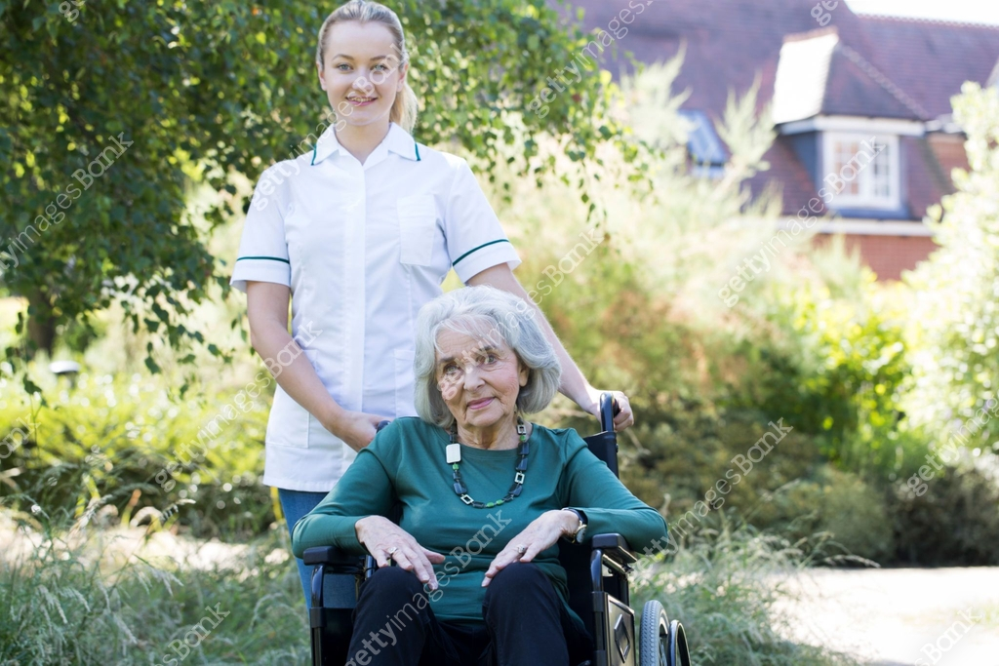

Dependent Carers’ Allowance
Childcare £8.21 per hour per child
Older People £13.06 per hour
Physical or Sensory Impairment £12.97 per hour
Learning Disability £13.55 per hour
Notes:
Members whilst undertaking Approved Duties who incur costs for childcare or professional fees to care for elderly, sick or dependent relatives can have those costs reimbursed on production of a receipt, up to a maximum of:
Please talk to us about these areas

Slide 14
When you make your expenses claim…
All claims for expenses must be made using My Oracle.
Any claim must be supported with attached receipts - any claim without such a receipt will not be paid except in exceptional circumstances at the discretion of the Monitoring Officer.
All claims made by Members, once paid, become a matter of public record and are published on the ECC website.
All claims for expenses must be made using My Oracle.
Any claim must be supported with attached receipts - any claim without such a receipt will not be paid, except in exceptional circumstances at the discretion of the Monitoring Officer.
All claims made by Members, once paid, become a matter of public record and are published on the ECC website.
Notes:
There are no exceptions to this. Paper-based claims are not accepted at ECC.

Slide 15
Check that all is correct before you submit your claim…
It is important both to protect the public purse and also for your protection that all claims made and payments made are in accord with the approved Scheme and are fully supported by receipts
It is your responsibility to ensure that what is claimed is correct – and help and guidance is available to you for this
Claims must be made within four months of the Approved Duty for which you are claiming.
On (or as soon as possible after) the 1st of each month

Slide 16
Line entries and descriptions
Because we have to check it - is important that we understand it!
To say ‘home to CH for Council and return’ is acceptable. We know that CH is County Hall and we know where you live.
‘Home to CH for meeting’ is insufficient. We need to know what meeting in order to determine if it is an Approved Duty or not.
We will also seek clarification from you if your line entry says something like: ‘To CH - DJ & GJ/BP’.
Please ensure you include the address or at least the post code of any duty that is not at County Hall.
We prefer to clarify rather than to reject – but clarification leads to delay.

Slide 17
More about mileage claims - receipts
Mileage is reimbursed at the rate of 55p per mile. This increases to 60p if you are carrying a passenger (they are also required to be attending an approved duty)
In order to support a claim for mileage not only must the journey be for an Approved Duty it must also be supported by fuel receipts.
Fuels receipts must: be dated close to the claim period, amount to roughly one-third of the total mileage claimed and display a VAT number.
If you use an electric or hybrid car, please speak to the Democracy Team, alternative arrangements apply.
Notes:
If you have an electric vehicle talk to us

Slide 18
Other receipts – rail, parking etc.
All claims must be supported by receipts.
It is particularly helpful if the scanned copies of your receipts are structured in such a way as to help us identify each receipt against each claim.
Please do not use highlighter pens on your receipts (they don’t scan well and obscure the very thing you are highlighting).
If you are not sure if a receipt is acceptable – please ask.

Slide 19
Deadlines
In order to comply with payroll deadlines and get your expenses to you as quickly and as efficiently as possible it is helpful to follow a few simple guidelines:
Make your expenses claims once a month - or in groups of months eg June/July.
It is best to submit your claims by the end of each month (for the month just ended) to give us time to process them.
Don’t fall behind with your claims; the Scheme requires that all claims are made within four months... but more timely and regular claims are much better.

Slide 20
It’s also worth remembering…
All allowances and expenses paid to Members are a matter of public record. We seek full transparency so;
All payments made to you are published on our website monthly.
All payments are subject to Freedom of Information requests (and these are frequently made by the public and the press).
The detail supporting the claim, including the receipts, extracts from the e-payroll system and emails relating to the claims are all subject to FOIs
All FOI responses are also published on our website.
Clear descriptions and accurate claims protect both you and the Council.

Slide 21
Context
At Essex we aim for the system to be clear, transparent and evidenced
Monthly and Annual reports are published on our website
https://www.essex.gov.uk/about-council/your-councillor/expenses-and-allowances

Slide 22
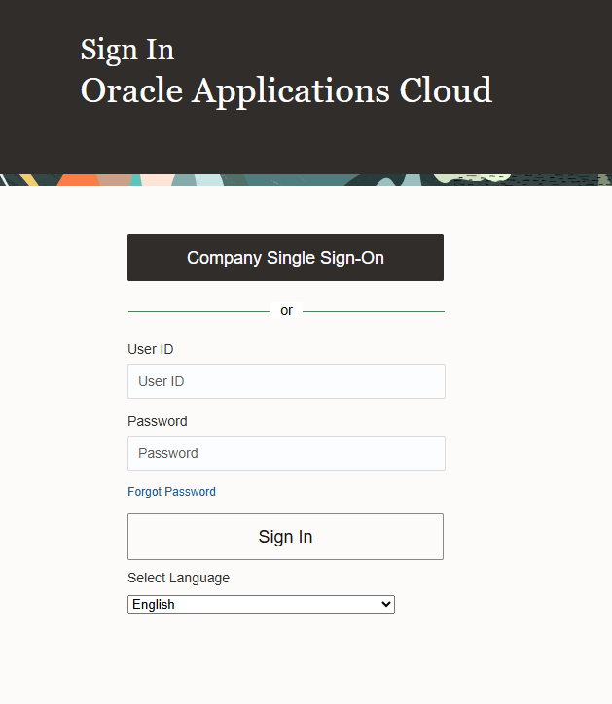
What is My Oracle?
My Oracle is an online system for all ECC employees, managers and Members to view their payslips and to submit, update and approve payroll and expenses information.
Notes:
Jaz –
This part of the session will introduce the My Oracle system and help you make your first claim for Members’ Expenses.
At the end of the session you should have an overview of the system, know how to log on and make a claim and know how to obtain further help and guidance.
My Oracle is designed to allow you to view certain information about your employment.
The system is secure and accessible via single sign on – if you are signed in to your ECC laptop you should be able to log-in to the system without repassword protected login

Slide 23
What can My Oracle do for you?
See your monthly payslips at any time
Update your personal information (about your bank or your vehicle details) instantly
Check past payments and progress on your claims
Access My Oracle anywhere from your ECC Laptop (Home / Office / County Hall)
Notes:
Jaz
For Members the system can be used to
View Payslips
View & Update Personal & Bank Details
Submit expense claims

Slide 24
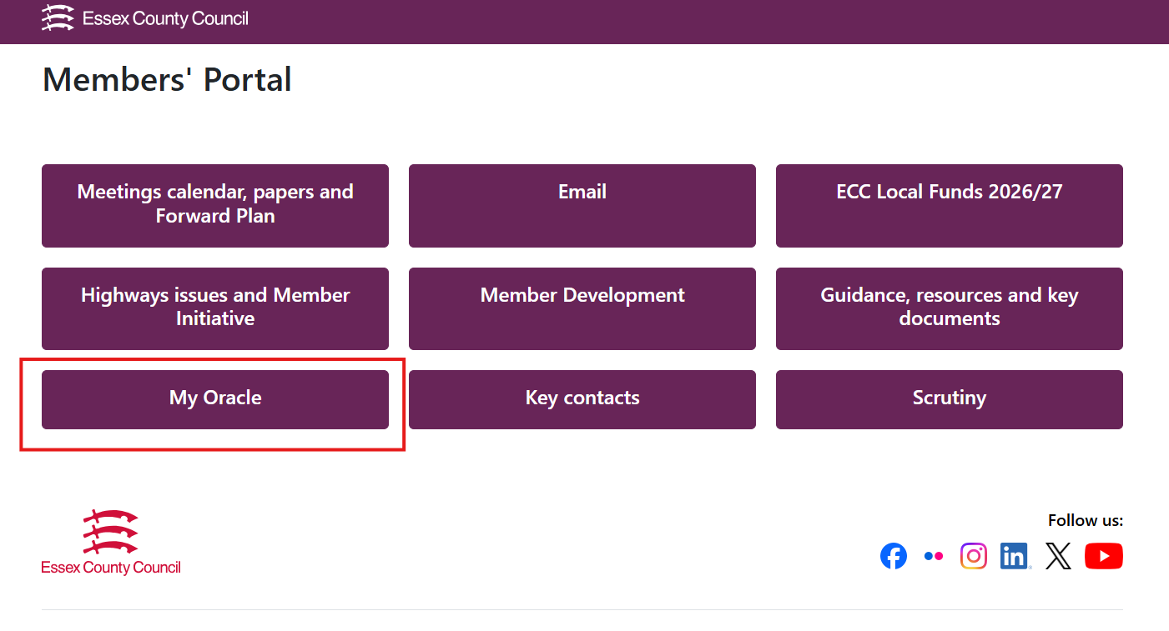
https://members.essex.gov.uk/
How to log-in to My Oracle
Notes:
The easiest and best way to access My Oracle is through the Member Portal. There is a quick link to it there for ease.

Slide 25
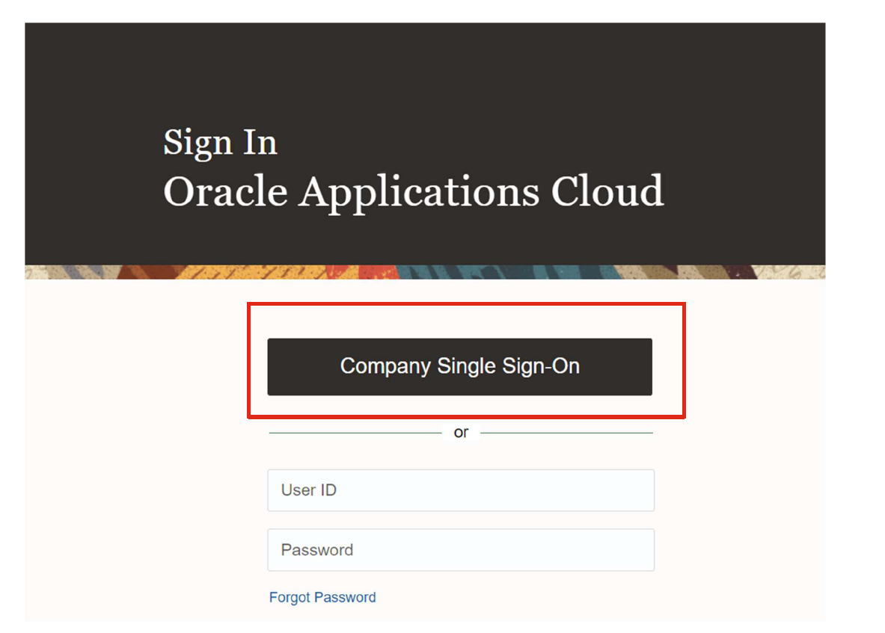
The first time you use your login
Notes:
Jaz –
You will be able to use company single sign on which means the system recognises you are logged into your ECC profile on your laptop so you do not have to input your password again.

Slide 26
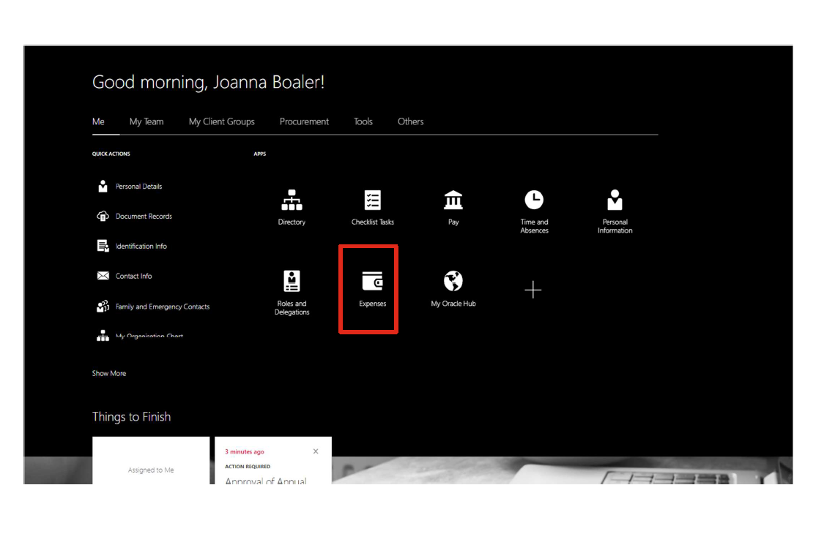
My Oracle Home Screen
Notes:
Jaz
From the My Oracle Home Page, select Me from the horizontal menu bar.
From the Apps area in the centre of the screen, select Expenses icon

Slide 27
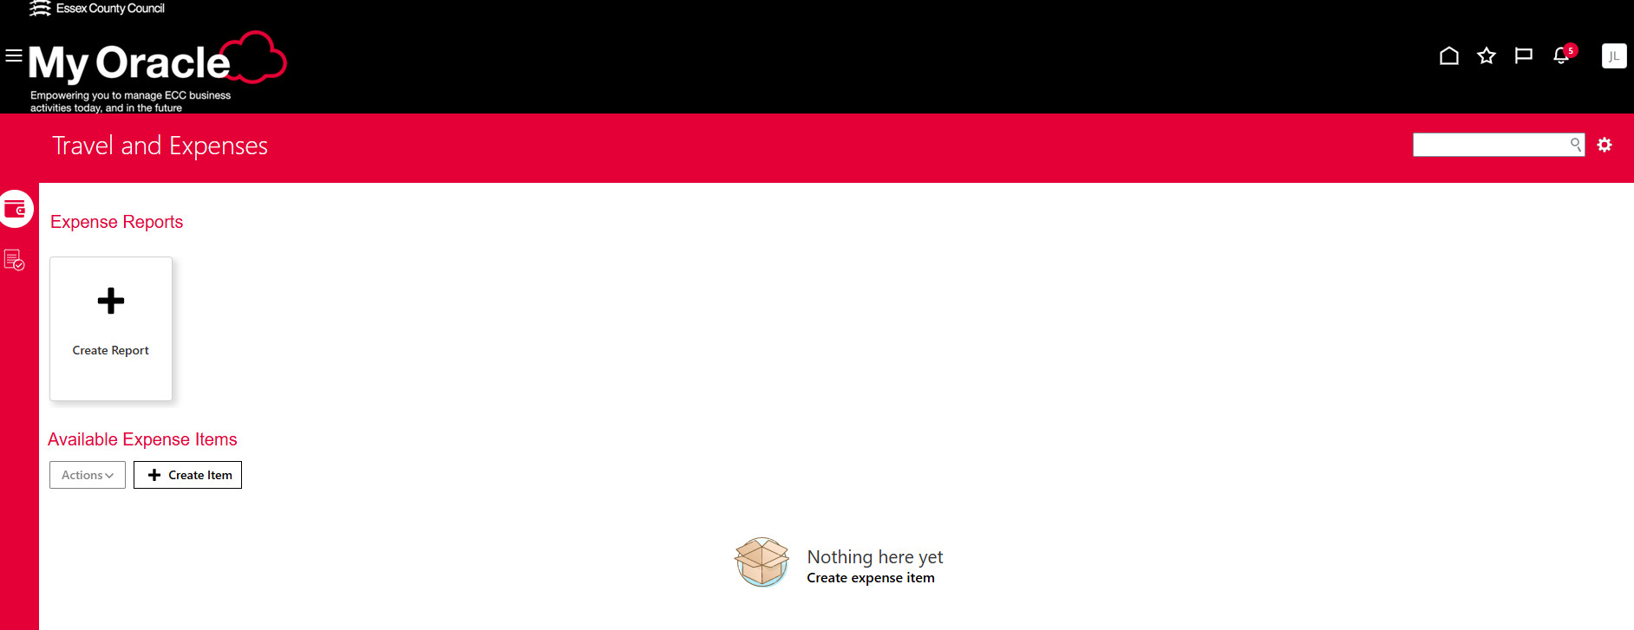
Example of completing an expense claim
Notes:
Jaz
Once in the expenses area this screen will show you if you have any outstanding reports and allow you to create new ones
Select ‘create report’

Slide 28
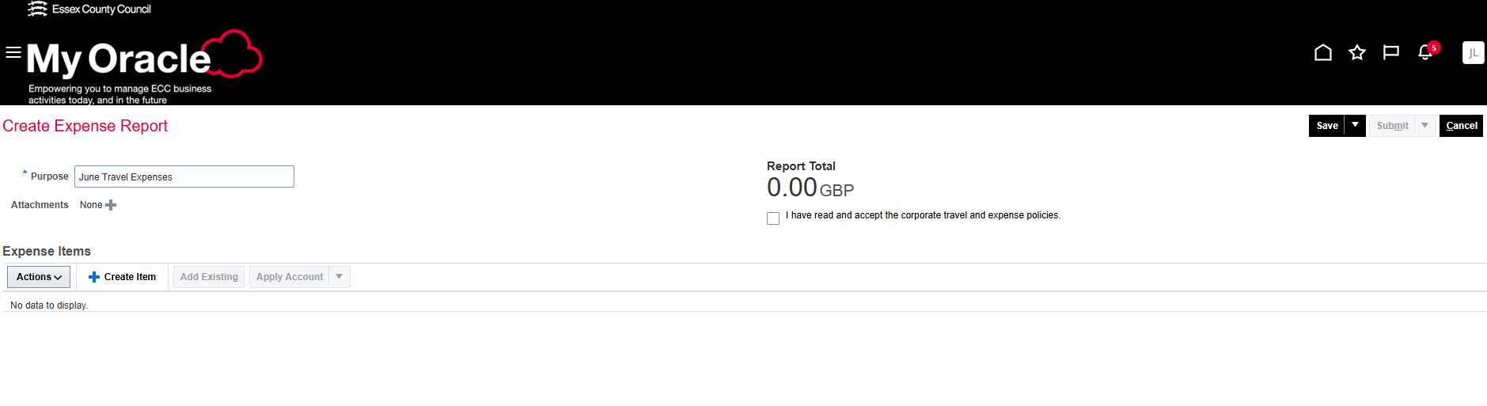
Example of completing an expense claim
Notes:
Jaz
If you click into ‘create report’ this is the screen you will see. Under ‘purpose’ type the month and year of the Expense Report.
Then Click the field below it called Expense Items and click + Create Item

Slide 29
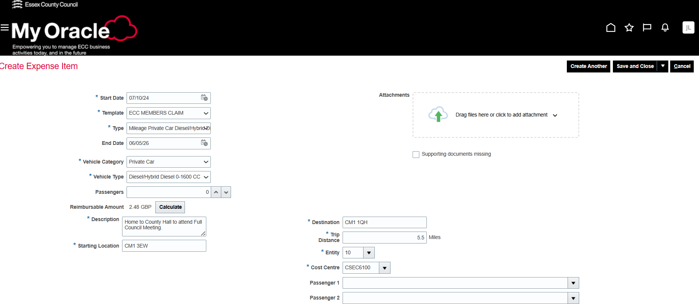
Example of completing an expense claim
Notes:
Jaz
This image shows what information is required when ‘creating an item’ this is essentially the individual journey details.
In the first field called Date, select the calendar icon and click on the date the item was purchased. This should match the date on any receipt/evidence which is attached. Please ensure the start date is the date of the journey you completed – not todays date! This is so when we cross check any journeys for meetings if required.
In the Template field please ensure it is set to ‘ECC Members Claim’
Use the drop-down menu in the Type field to find a description of the expense, e.g. mileage, public transport etc
Passengers – if you are carrying a passenger please indicate it here and also tell us who it was using the description box – as the system doers not allow me to see this information. As covered previously you can only claim for an additional passenger if they are a member and were also taking part in an approved duty. By carrying a passenger you can claim 60p per mile as opposed to 55p.
Once you input the starting location, destination and the trip distance the system will calculate the reimbursable amount.
The description box is very important as I am limited to what I can see once a claim is sent to me – although you input the postcodes I cannot see that detail and so even though you have already noted them – the description box is where you need to be very clear and informative in your submission. For example ‘Home to County Hall for Full Council meeting.’ is fine as I am aware of ch’ postcode For meetings not held at County Hall please provide the postcode and description of the meeting for example ‘Meeting with resident’ is not sufficient – where did this take place, what was the purpose of the meeting? The more info the better!
On the right of the screen there is a field called Attachments. All expense claims require a valid receipt or evidence of payment which can be attached here. If you are submitting multiple journeys in one claim, you may not have a different petrol receipt for each journey – please ensure the receipts are attached to at least one journey and then check the box titled Receipt Missing for any others. Later in the process you will be directed to add a comment, explaining why a receipt is not available.
If you have another purchase to add to this Expense Report, select Create Another and repeat the process

Slide 30
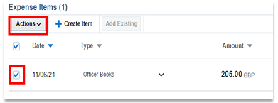

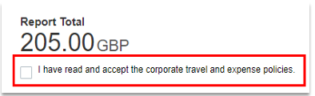
Example of completing an expense claim
Notes:
Jaz
To edit any information, click into the check box to the left of the entry and select the Actions button that appears above the items you have added, then choose to Edit, Delete or Duplicate your entry from the Actions drop-down menu
Once you have added all the required entries, click the ‘I have read and accept the corporate travel and expense policies’ check box in the centre.
To the top right of the screen you have three options. Choose to Save the report without submitting it for processing or Submit the report for processing or Cancel to delete the content of the report.
Access the report from the My Oracle Home Page. Click on the Expenses icon in the Apps area. The screen will show you reports that you have saved or submitted

Slide 31
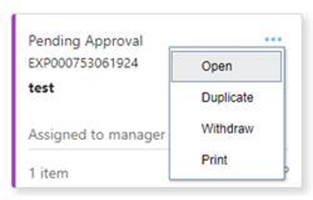
Example of completing an expense claim
Notes:
Jaz
On the home screen you can see all the claims you have submitted and their progress.
Using the More Options (three dots …) menu to the top right of the relevant report, you can choose to:
Open the report Submit the report (if the report has been saved but not yet submitted)
Duplicate the report (this is not recommended)
Withdraw the report to make changes
Delete the report
Print the report.
This is sometimes useful as if I have a query or we need to ask you to add more information to your claim you are able to withdraw the claim and make the changes then re-submit it so I do not need to reject the whole claim which gets rid of the whole claim. This way we can work together to ensure the claim is ready to be submitted.

Slide 32
Support and Guidance
If you need support or guidance about what you may claim or about using the e-payroll system please ask:
The Democracy Team, Jasmine Langley
Joanna Boaler or Paul Turner
There is further detailed guidance in The Constitution – The Members Allowance Scheme and on the Members Portal.

Slide 33

This Photo by Unknown Author is licensed under CC BY-NC

